Slide 1
History of Software Insecurity
CSE 545 – Software Security
Spring 2016
Adam Doupé
Arizona State University
http://adamdoupe.com
Content of some slides provided by Giovanni Vigna of UCSB, with approval

Slide 2
The Internet
A "network of networks"
Composed of a set of autonomous subnetworks
Open architecture
Different administrative domains with different (and sometimes conflicting) goals
The Internet is critical to our lives

Slide 3
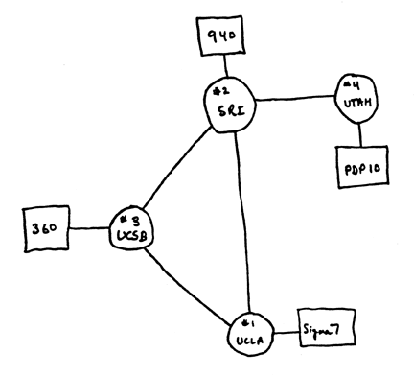
Internet History '70s
The Defense Advanced Research Project Agency (DARPA) developed ARPANET
First four nodes (1969):
University of California, Los Angeles
University of California, Santa Barbara
Stanford Research Institute
University of Utah
Based on the Network Control Protocol (NCP)

Slide 4
Internet History '80s
ARPANET moves to TCP/IP (January 1st, 1983)
DARPA funds the development of Berkeley UNIX (TCP/IP implementation that introduces the socket programming abstraction)
APRANET becomes a subset of the Internet (and MILNET detaches)
The National Science Foundation (NSF) creates a supercomputer network, NFSNET, supported by a "backbone" (56Kbps link in 1986)

Slide 5
Internet History '90s and '00
Fast growth (size and volume)
1991: Tim Berners-Lee at CERN creates the World Wide Web
The Internet explodes

Slide 7
http://www.opte.org/

Slide 8
A Brief History of Notable Hacking
1972 phone phreaking
December 1972, Bob Metcalfe "The Stockings Were Hung by the Chimney with Care," RFC #602
August 1986, German hackers try to obtain secrets to be sold to the KGB
November 1988, The Internet worm
December 1994, Kevin Mitnick attacks Supercomputer Center
March 2010, Albert Gonzales receives 20-year sentence for hacking
…

Slide 9
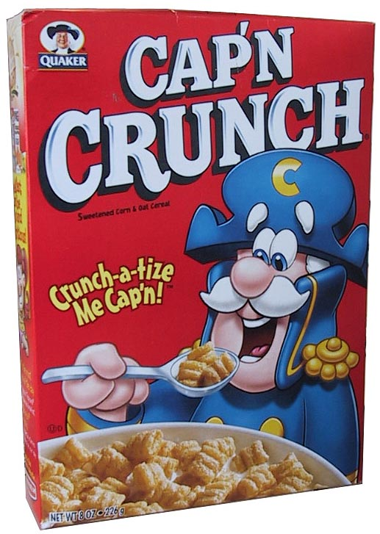
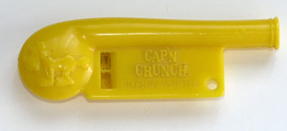
Cap'n Crunch
In 1972 John Draper finds that the whistle that comes with the Cap’n Crunch cereal produces a sound at the 2600 Hz frequency
The 2600 frequency was used by AT&T to authorize long-distance calls

Slide 10
Phone Phreaking
John Draper became known as "Captain Crunch" and built a "blue box"
Blue box produced a number of different tones that could be used for in-band signaling
Draper was eventually sentenced to five years' probation for phone fraud
Why do we care?

Slide 11
Early Warnings
Bob Metcalfe "The Stockings Were Hung by the Chimney with Care," RFC #602, December 1973
The ARPA Computer Network is susceptible to security violations for at least the three following reasons:
(1) Individual sites, used to physical limitations on machine access, have not yet taken sufficient precautions toward securing their systems against unauthorized remote use. For example, many people still use passwords which are easy to guess: their first names, their initials, their host name spelled backwards, a string of characters which are easy to type in sequence (e.g. ZXCVBNM).

Slide 12
Early Warnings
(2) The TIP allows access to the ARPANET to a much wider audience than is thought or intended. TIP phone numbers are posted, like those scribbled hastily on the walls of phone booths and men's rooms. The TIP required no user identification before giving service. Thus, many people, including those who used to spend their time ripping off Ma Bell, get access to our stockings in a most anonymous way.
(3) There is lingering affection for the challenge of breaking someone's system. This affection lingers despite the fact that everyone knows that it's easy to break systems, even easier to crash them.

Slide 13
Early Warnings
All of this would be quite humorous and cause for raucous eye winking and elbow nudging, if it weren't for the fact that in recent weeks at least two major serving hosts were crashed under suspicious circumstances by people who knew what they were risking; on yet a third system, the system wheel password was compromised -- by two high school students in Los Angeles no less. We suspect that the number of dangerous security violations is larger than any of us know is growing. You are advised not to sit "in hope that Saint Nicholas would soon be there".

Slide 14
The German Hacker Incident
Cliff Stoll was a system administrator at LBL in August 1986
He was a physics student
On his first day, he started investigating a 75 cent accounting discrepancy for CPU time
He found out that an account had been created with no billing address
More investigation identified the presence of an intruder
Stoll (with encouragement by the FBI) monitored the intruder to find out who they were and how they gained access

Slide 15
The German Hacker Incident
Configuration problem in Emacs
Emacs can work as a mailer and it used the "movemail" program to move a user's email from /var/spool/mail to their home diretory
LBL configuration needed "movemail" to have root (advanced) privileges

Slide 16
The German Hacker Incident
In this configuration, movemail allowed anybody to move files to any directory of the system
Hacker exploited the bug to substitute his own copy of the "atrun" program
After execution, the legitimate atrun program was copied back

Slide 17
The German Hacker Incident
Hacker gained administrative access and created accounts and backdoor programs
Used the LBL to connect to military systems in the MILNET
Military sites and databases were searched for keywords such as “SDI” (Strategic Defense Initiative), “stealth”, “SAC” (Strategic Air Command), “nuclear”, “NORAD”
Stoll called the FBI

Slide 18
The German Hacker Incident
With the help of the FBI and of the Bundeskriminalamt (BKA) he was able to trace the intruder to Hanover
1989: the investigation ends with the arrest of Markus Hess in Germany, who apparently worked for the Eastern Bloc
Markus was sentenced to a year and eight months and a 10,000 DM fine – He was put on probation
Other “hackers” were involved in the break-in and received similar sentences

Slide 19
The Cuckoo's Egg
Cliff Stoll's own account of the incident
http://www.amazon.com/The-Cuckoos-Egg-Tracking-Espionage/dp/1416507787

Slide 20
The Internet Worm
November 2nd, 1988: The "Internet worm," developed by Robert T. Morris (hacker alias RTM) was released
Mistake in the replication procedure led to unexpected proliferation
The Internet had to be "turned off"
Damages were estimated on the order of several hundred thousand dollars
RTM was sentenced to three years' probation, a $10,000 fine, and 400 hours community service
CERT (Computer Emergency Response Team) was created in reaction

Slide 21
The Worm
A worm is a self-replicating program that spreads across a network of computers
The worm worked only on Sun 3 systems and VAX computers running BSD UNIX
The worm consisted of two parts:
A main program
A bootstrap program

Slide 22
The Worm
First Step: Remote privileged access
finger buffer overflow
char line[512];
line[0] = '\0';
gets(line);
sendmail
DEBUG option allows one to specify a number of commands to execute
The bootstrap program (99 lines of C) was transferred to the machine
The bootstrap program was compiled and run, causing the transfer of a precompiled version of the main program to the infected host

Slide 23
The Worm
The main program
Gathered information about the network interfaces and open connections
Tried to break into hosts using rsh, finger, or sendmail
Gathers information on "trusted hosts"
/etc/hosts.equiv
/.rhosts
~/.forward
Tries to rsh to the referenced hosts
Performs a password cracking attack
On each successful break-in the bootstrap was transferred

Slide 24
The Worm
http://blog.wfmu.org/freeform/2008/05/a-brief-history.html

Slide 25
Kevin Mitnick
One of the most well-known "hackers"
1982: One-year probation for breaking into PacBell’s offices
1982: Enrolls at University of Southern California and uses campus machines to perform illegal activities: 6 months of juvenile prison in Stockton, California
1987: Mitnick breaks into SCO. Sentence: three-year probation
1988: Enrolls at Pierce and misuses campus systems. Expelled, appealed unsuccessfully
1988: Mitnick breaks into DEC and steals software. Caught by FBI. One-year sentence at Lompoc, California

Slide 26
Kevin Mitnick
1992: Mitnik violates probation and goes into hiding
1994: California Department of Motor Vehicles issues $1M warrant for Mitnick's arrest
Christmas 1994: Mitnick accused of invading San Diego Supercomputer Center

Slide 27
Attack Against SDSC
Sophisticated TCP spoofing attack
Attack exploits the trust between two hosts
x-terminal: diskless SPARCstation running Solaris 1
server: host providing boot image to x-terminal
x-terminal allows unauthenticated logins (and command requests) coming from server
Denial-of-service attack against server
Impersonation of server with respect to the x-terminal executing
rsh x-terminal "echo ++ >> /.rhosts"
https://www.eecis.udel.edu/~bmiller/cis459/2007s/readings/mitnick.html

Slide 28
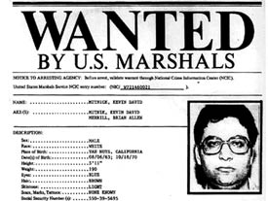
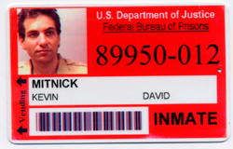
Kevin Mitnick
February 1995: FBI arrests Mitnick in Raleigh, North Carolina. Sentenced to 46 months in prison (concurrently with a 22-month sentence)
January 2000: Mitnick released from prison after almost 5 years (probation forbade him from connecting to the Internet or sending e-mail)
January 2003: Mitnick can surf the Internet after 8 years

Slide 29
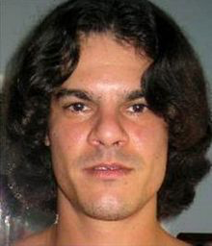
Albert Gonzalez

Slide 30
Albert Gonzalez
He and his crew used SQL injection vulnerabilities to steal credit cards
Total stolen ~ 170 million credit cards
Responsible for
Dave & Busters (May 2008)
TJ Maxx (May 2008)
Heartland Payment (August 2009)
On March 25th, 2010 he was sentenced to 20 years in federal prison

Slide 31
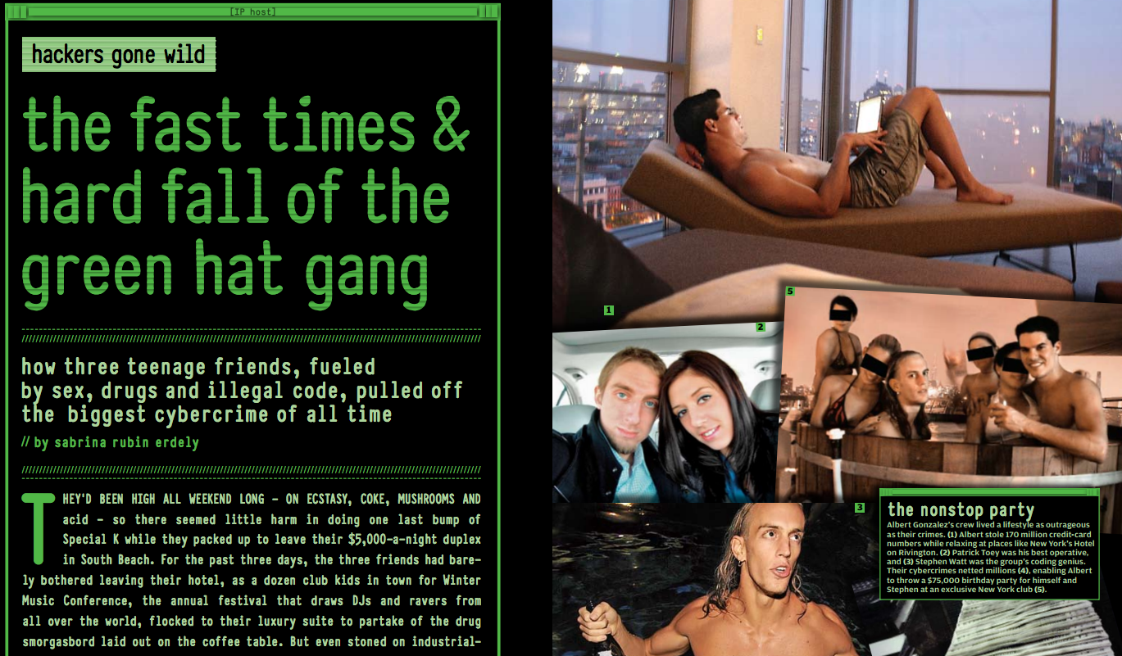

Slide 32
Other Stories
Vitek Boden, age 48, attacked the Maroochy Shire Council (MSC) sewerage system in Queensland, Australia from December 1999 through April 2000
Caused raw sewage overflows on Australia’s Sunshine Coast
Hundreds of thousands of liters of raw sewage flowed into waterways at Pacific Paradise and grounds of Hyatt Regency Resort
Marine life died, creek turned black, unbearable stench
Boden convicted of 30 counts of hacking the MSC’s sewerage system
Sentenced to 2 years in prison

Slide 33
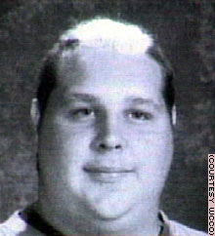
Other Stories
Web defacements
Worms
Swen, SoBig, Nimda, Code Red, Slammer, Blaster, ...
Blaster’s author: Jeffrey Lee Parson, 18

