Slide 1
Web Basics
CSE 365 – Information Assurance
Fall 2023
Adam Doupé
Jaejong Baek
Arizona State University
Content of some slides provided by Giovanni Vigna of UCSB, with approval

Slide 2
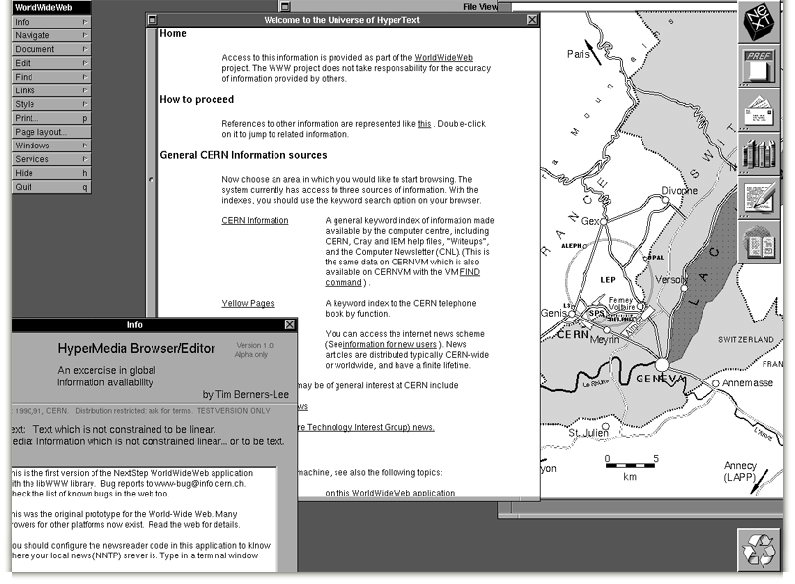
Notes:
First web browser

Slide 3
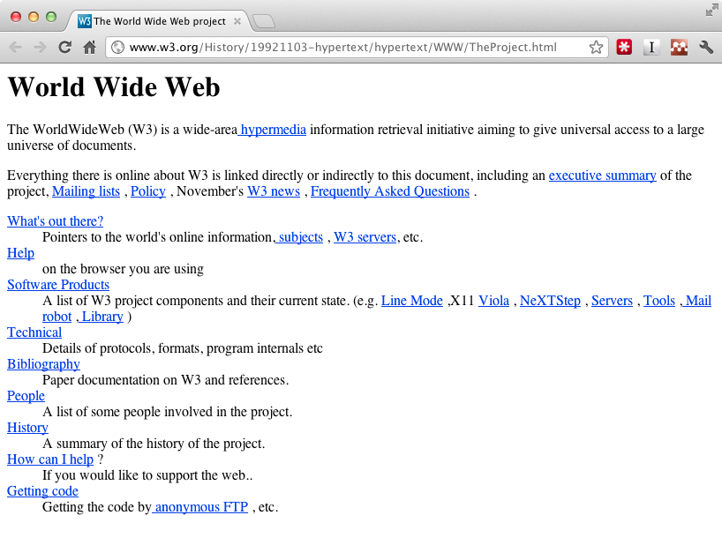
Notes:
First website

Slide 4

Sir Tim Berners-Lee

Slide 5
Birth of the Web
Created by Tim Berners-Lee while he was working at CERN
  First CERN proposal in 1989
  Finished first website end of 1990
Weaving the Web: The Original Design and Ultimate Destiny of the World Wide Web, Tim Berners-Lee
Notes:
Question: Birth of Internet and the Web?
Difference?

Slide 6
Design
Originally envisioned as a way to share research results and information at CERN
Combined multiple emerging technologies
  Hypertext
  Internet (TCP/IP)
Idea grew into “universal access to a large universe of documents”

Slide 7
Three Central Questions
How to name a resource?
How to request and serve a resource?
How to create hypertext?

Slide 8
Three Central Technologies
How to name a resource?
  Uniform Resource Identifier (URI/URL)
How to request and serve a resource?
  Hypertext Transfer Protocol (HTTP)
How to create hypertext?
  Hypertext Markup Language (HTML)

Slide 9
URI
HTTP
HTML
Notes:
Relationship between the three core technologies.
URIs describe how to make an HTTP request, and an HTTP response contains HTML, which contains data plus URIs for more information.

Slide 10
URI
HTTP
HTML
Notes:
Relationship between the three core technologies.
URIs describe how to make an HTTP request, and an HTTP response contains HTML, which contains data plus URIs for more information.

Slide 11
Uniform Resource Identifier
Essential meta-data to reach/find a resource
Answers the following questions:
  Which server has it?
  How do I ask?
  How can the server locate the resource?
Latest definition in RFC 3986 (January 2005)

Slide 12
URI – Syntax
<scheme>:<authority>/<path>?<query>#<fragment>

Slide 13
URI – Syntax
<scheme>:<authority>/<path>?<query>#<fragment>
scheme
  The protocol to use to request the resource
authority
  The entity that controls the interpretation of the rest of the URI
  Usually a server name
    <username>@<host>:<port>
path
  Usually a hierarchical pathname composed of “/” separated strings
query
  Used to pass non-hierarchical data
fragment
  Used to identify a subsection or subresource of the resource

Slide 14
URI – Syntax
<scheme>:<authority>/<path>?<query>#<fragment>
Examples:
foo://example.com:8042/over/there?test=bar#nose
ftp://ftp.ietf.org/rfc/rfc1808.txt
mailto:doupe@asu.edu
https://example.com/test/example:1.html?/adam
Notes:
What is the scheme, authority, path, query, and fragment of each example?
Is each example a URI?

Slide 15
URI – Reserved Characters
:
/
?
#
[
]
@
!
$
&
‘
(
)
*
+
,
;
=

Slide 16
URI – Percent Encoding
Must be used to encode anything that is not of the following:
Alpha [a-zA-Z]
Digit [0-9]
-
.
_
~

Slide 17
URI – Percent Encoding
Encode a byte outside the range with percent sign (%) followed by hexadecimal representation of byte
  & -> %26
  % -> %25
  <space> -> %20
  …
Let’s fix our previous example:
  https://example.com/test/example:1.html?/adam
  https://example.com/test/example%3A1.html?%2Fadam

Slide 18
URI – Absolute vs. Relative
URI can specify the absolute location of the resource
  https://example.com/test/help.html
Or the URI can specify a location relative to the current resource
  //example.com/example/demo.html
    Relative to the current network-path (scheme)
  /test/help.html
    Relative to the current authority
  ../../people.html
    Relative to the current authority and path
Context important in all cases
  http://localhost:8080/test

Slide 19
Hypertext Transport Protocol
Protocol for how a web client can request a resource from a web server
Based on TCP, uses port 80 by default
Version 1.0
  Defined in RFC 1945 (May 1996)
Version 1.1
  Defined in RFC 2616 (June 1999)
Version 2.0
  Based on SPDY, still under discussion

Slide 20
HTTP – Overview
Client
  Opens TCP connection to the server
  Sends request to the server
Server
  Listens for incoming TCP connections
  Reads request
  Sends response
Notes:
Deliberately vague!

Slide 21



HTTP – Overview
HTTP Request
HTTP Response
Server
Client

Slide 22

HTTP – Overview
Cache
Server
Client
Cache
Firewall
Proxy

Slide 23
Requests
An HTTP request consists of:
  method
  resource (derived from the URI)
  protocol version
  client information
  body (optional)

Slide 24
Requests – Syntax
Start line, followed by headers, followed by body
  Each line separated by CRLF
Headers separated by body via empty line (just CRLF)

Slide 25
Requests – Methods
The method that that client wants applied to the resource
Common methods
    GET – Request transfer of the entity referred to by the URI
    POST – Ask the server to process the included body as “data” associated with the resource identified by the URI
    PUT – Request that the enclosed entity be stored under the supplied URI
    HEAD – Identical to GET except server must not return a body

Slide 26
Requests – Methods
OPTIONS – Request information about the communication options available on the request/response chain identified by the URL
DELETE – Request that the server delete the resource identified by the URI
TRACE – used to invoke a remote, application-layer loop-back of the request message and the server should reflect the message received back to the client as the body of the response
CONNECT – used with proxies
…
  A webserver can define arbitrary extension methods

Slide 27
Requests – Example
GET / HTTP/1.1
User-Agent: curl/7.37.1
Host: www.google.com
Accept: */*

Slide 28
Modern Requests
GET / HTTP/1.1
Host: www.google.com
Accept-Encoding: deflate, gzip
Accept: text/html,application/xhtml+xml,application/xml;q=0.9,image/webp,*/*;q=0.8
User-Agent: Mozilla/5.0 (Macintosh; Intel Mac OS X 10_10_1) AppleWebKit/537.36 (KHTML, like Gecko) Chrome/39.0.2171.95 Safari/537.36
Notes:
From Chrome to www.google.com

Slide 29
Responses
An HTTP response consists of:
  protocol version
  status code
  short reason
  headers
  body
Notes:
This is where we ended the first day.

Slide 30
Responses – Syntax
Status line, followed by headers, followed by body
  Each line separated by CRLF
Headers separated by body via empty line (just CRLF)
Almost the same overall structure as request

Slide 31
Responses – Status Codes
1XX – Informational: request received, continuing to process
2XX – Successful: request received, understood, and accepted
3XX – Redirection: user agent needs to take further action to fulfill the request
4XX – Client error: request cannot be fulfilled or error in request
5XX – Server error: the server is aware that it has erred or is incapable of performing the request

Slide 32
Responses – Status Codes
"200" ; OK
"201" ; Created
"202" ; Accepted
"204" ; No Content
“301" ; Moved Permanently
"307" ; Temporary Redirect

Slide 33
Responses – Status Codes
"400" ; Bad Request
"401" ; Unauthorized
"403" ; Forbidden
"404" ; Not Found
"500" ; Internal Server Error
"501" ; Not Implemented
"502" ; Bad Gateway
"503" ; Service Unavailable

Slide 34
Requests – Example
GET / HTTP/1.1
User-Agent: curl/7.37.1
Host: www.google.com
Accept: */*

Slide 35
Responses – Example
HTTP/1.1 200 OK
Date: Tue, 13 Jan 2015 03:57:26 GMT
Expires: -1
Cache-Control: private, max-age=0
Content-Type: text/html; charset=ISO-8859-1
Set-Cookie: …
Server: gws
X-XSS-Protection: 1; mode=block
X-Frame-Options: SAMEORIGIN
Alternate-Protocol: 80:quic,p=0.02
Accept-Ranges: none
Vary: Accept-Encoding
Transfer-Encoding: chunked
<!doctype html><html itemscope="" itemtype="http://schema.org/WebPage" lang="en"><head><meta content="Search the world's information, including webpages, images, videos and more. Go …

Slide 36
Maintaining State
HTTP is a stateless protocol
However, to write a web application we would like maintain state and link requests together
The goal is to create a "session" so that the web application can link requests to the same user
  Allows authentication
  Rich, full applications
Three ways this can be achieved
  Embedding information in URLs
  Using hidden fields in forms
  Using cookies
Notes:
While the last option is the most common, it's important to get an understanding of where we came from. Plus, there might be applications that use the other two features.

Slide 37
Embedding Information in Cookies
Cookies are state information that is passed between a web server and a user agent
  Server initiates the start of a session by asking the user agent to store a cookie
  Server or user agent can terminate the session
Cookies first defined by Netscape while attempting to create an ecommerce application
RFC 2109 (February 1997) describes first standardization attempt for cookies
RFC 2965 (October 2000) tried to standardize cookies 2.0
RFC 6265 (April 2011) describes the actual use of cookies in the modern web and is the best reference

Slide 38
Embedding Information in Cookies
Cookies are name-value pairs (seperated by "=")
Server includes the "Set-Cookie" header field in an HTTP response
  Set-Cookie: USER=foo;
User agent will then send the cookie back to the server using the "Cookie" header on further requests to the server
  Cookie: USER=foo;

Slide 39
Embedding Information in Cookies
Server can ask for multiple cookies to be stored on the client, using multiple "Set-Cookie" headers
  Set-Cookie: USER=foo;
  Set-Cookie: lang=en-us;

Slide 40
Embedding Information in Cookies
Server can sent several attributes on the cookie, these attributes are included in the Set-Cookie header line, after the cookie itself, separated by ";"
  Path
    Specifies the path of the URI of the web server that the cookies are valid
  Domain
    Specifies the subdomains that the cookie is valid
  Expires or Max-Age
    Used to define the lifetime of the cookie, or how long the cookie should be valid
  HttpOnly
    Specifies that the cookie should not be accessible to client-side scripts
  Secure
    Specifies that the cookie should only be sent over secure connections

Slide 41
Embedding Information in Cookies
Example cookie headers from curl request to www.google.com
  curl -v http://www.google.com
Set-Cookie: PREF=ID=db9539b9b7353be5:FF=0:TM=1421424672:LM=1421424672:S=OqGXMZZhmeyihyKi; expires=Sun, 15-Jan-2017 16:11:12 GMT; path=/; domain=.google.com
Set-Cookie: NID=67=bs1lLyrXtfdUj79IlcuqR7_MWEsyNdLWU_FpGKwlWR9QpEzi3UrVV2UGO6LBW3sJNk9mlLcYIJns3PG3NUu-M3pT9qD-V4F8oyyJ_UJnCGKDUDGbllL9Ha8KGufv0MUv; expires=Sat, 18-Jul-2015 16:11:12 GMT; path=/; domain=.google.com; HttpOnly

Slide 42
Set-Cookie: PREF=ID=db9539b9b7353be5:FF=0:TM=1421424672:LM=1421424672:S=OqGXMZZhmeyihyKi; expires=Sun, 15-Jan-2017 16:11:12 GMT; path=/; domain=.google.com
  expires is set two years in the future
  path is / which means to send this cookie to all subpaths of www.google.com/
  domain is .google.com, which means to send this cookie to all subdomains of .google.com
    Includes www.google.com, drive.google.com, …

Slide 43
Set-Cookie: NID=67=bs1lLyrXtfdUj79IlcuqR7_MWEsyNdLWU_FpGKwlWR9QpEzi3UrVV2UGO6LBW3sJNk9mlLcYIJns3PG3NUu-M3pT9qD-V4F8oyyJ_UJnCGKDUDGbllL9Ha8KGufv0MUv; expires=Sat, 18-Jul-2015 16:11:12 GMT; path=/; domain=.google.com; HttpOnly
  HttpOnly is a security feature, which means only send this cookie in HTTP, do not allow JavaScript code to access the cookie

Slide 44
Embedding Information in Cookies
The server can request the deletion of cookies by setting the "expires" cookie attribute to a date in the past
User agent should then delete cookie with that name
  Set-Cookie: USER=foo; expires=Thu, 1-Jan-2015 16:11:12 GMT;
    User agent will then delete the cookie with name "USER" that is associated with this domain
  Proxies are not supposed to cache cookie headers
    Why?

Slide 45
Embedding Information in Cookies
User agent is responsible for following the server's policies
  Expiring cookies
  Restricting cookies to the proper domains and paths
However, user agent is free to delete cookies at any time
  Space/storage restrictions
  User decides to clear the cookies

