Slide 1
Introduction to Cybersecurity
CSE 365 – Information Assurance
Fall 2023
Adam Doupé
Jaejong Baek
Arizona State University

Slide 2
Course Setup
Hybrid course, so half of your classes will be in-person, half will be remote (over twitch and recorded)
Mondays, 1:30pm – 2:45pm
Wednesdays, 1:30pm – 2:45pm
Attend your session in-person (if you want) and attend other session on twitch (or watch video recording)
  If we have enough space in the room, feel free to attend in-person both sessions
Always available on twitch: https://www.twitch.tv/pwncollege
Course syllabus: https://static.pwn.college/syllabi/cse365-f23

Slide 3
Introduction
Professor Adam Doupé
  PhD at UCSB
  Played CTF with Shellphish, then started the pwndevils @ ASU, which is now the mysterious ASU Hacking Club
    http://asuhacking.club
  OH: Mondays, 11:00 AM – 12:00 PM
  BYENG 472 or Zoom: https://asu.zoom.us/j/88211077168

Slide 4
Introduction
Professor Jaejong Baek
Assistant Teaching Professor, ASU SCAI
  PhD from Yonsei University
  Research: mobile and wireless network security (5G), access control, blockchain, digital forensics, and vehicle security
  https://jjbaek35.github.io
  OH: Monday and Wednesday 5PM--6PM (Zoom and In person)

Slide 5
TAs and UGTAs
Steven Wirsz
Robert Wasinger
Zeming Yu
Ati Priya Bajaj
TBA UGTAs

Slide 6
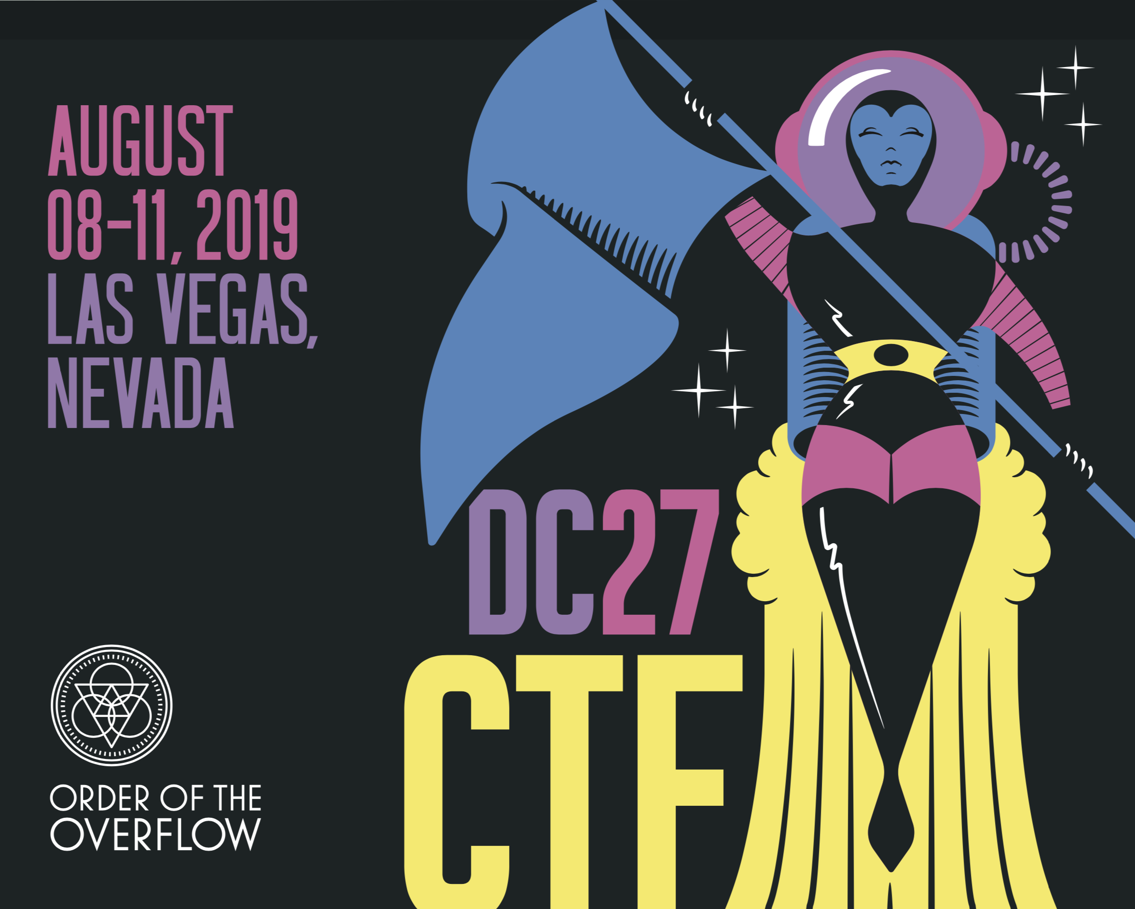
https://www.oooverflow.io/
https://github.com/o-o-overflow
https://twitter.com/oooverflow

Slide 7
Road to DEF CON 27 CTF
6 qualifying CTFs from around the world
1,200 teams competed in our qualification event in May

Slide 8
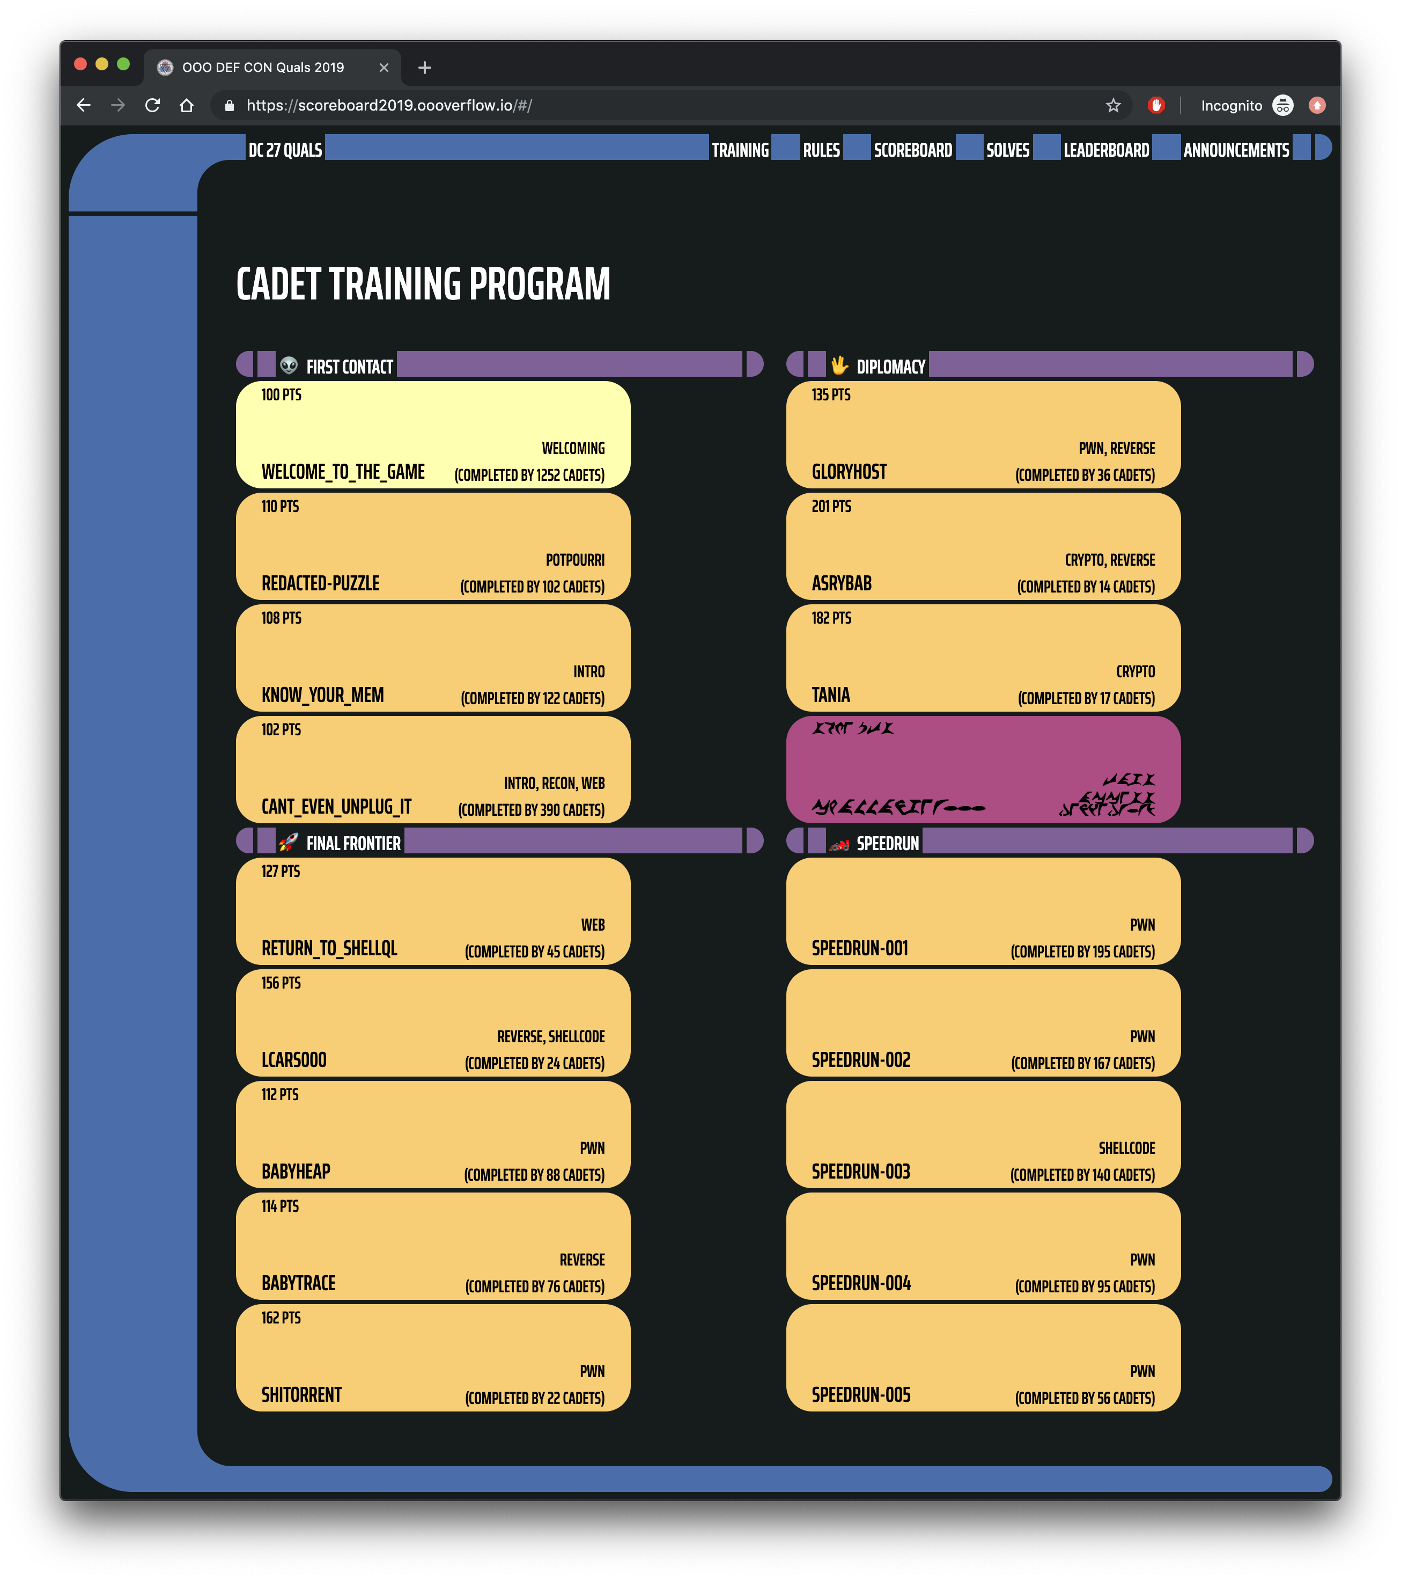
https://scoreboard2019.oooverflow.io/

Slide 9
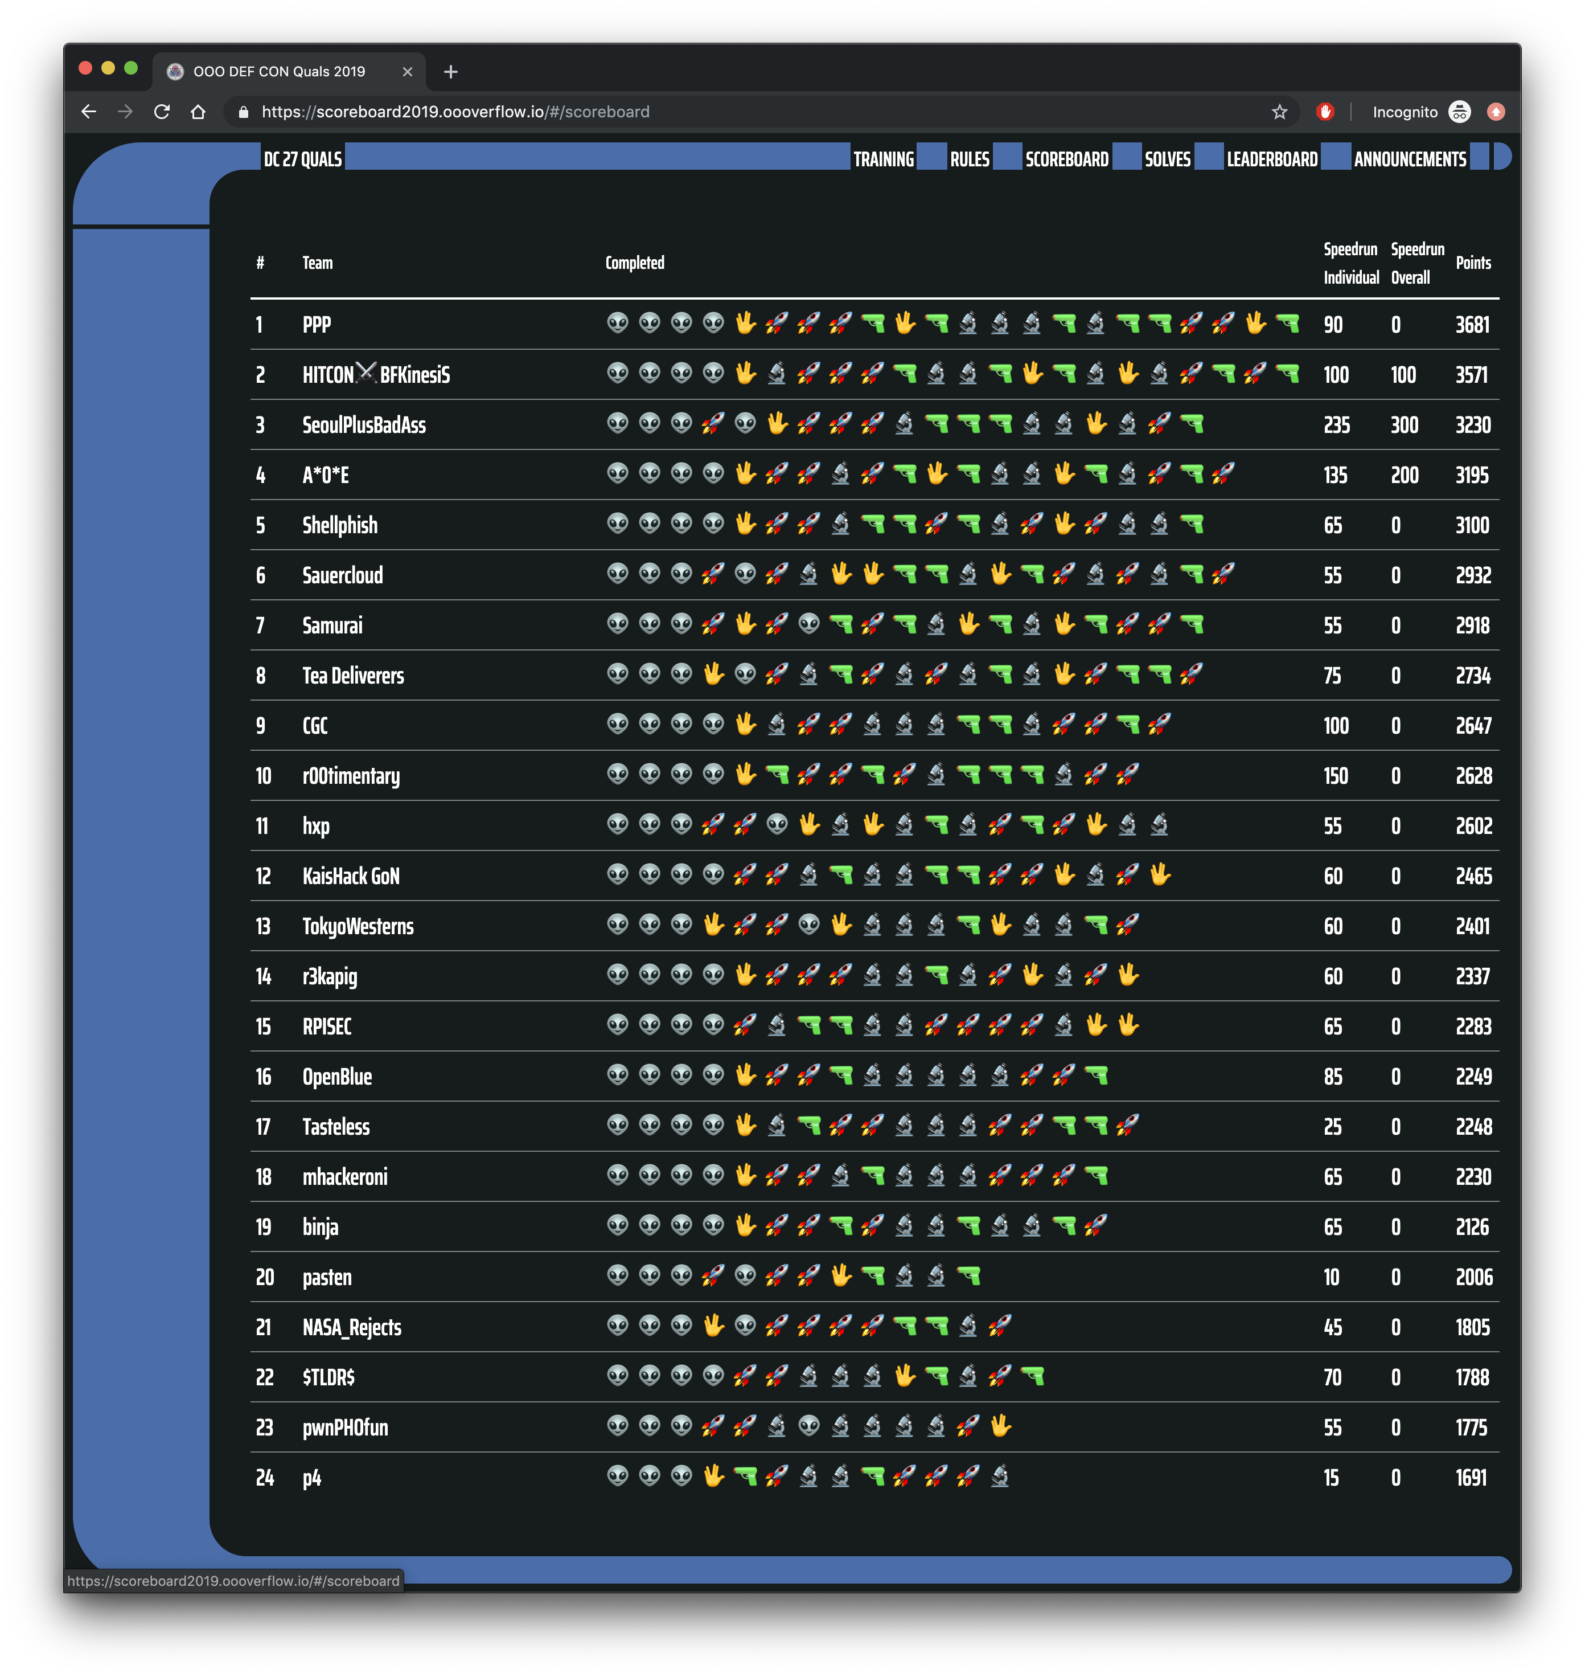

Slide 10
Road to DEF CON 27 CTF
6 qualifying CTFs from around the world
1,200 teams competed in our qualification event in May
Best 16 teams in the world invited to finals, co-located with the DEF CON security conference

Slide 11
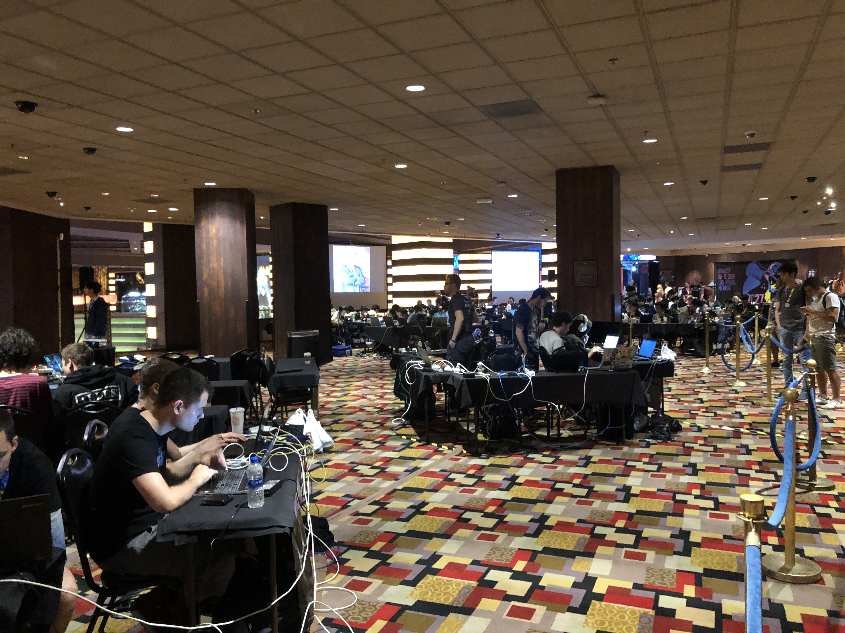

Slide 12
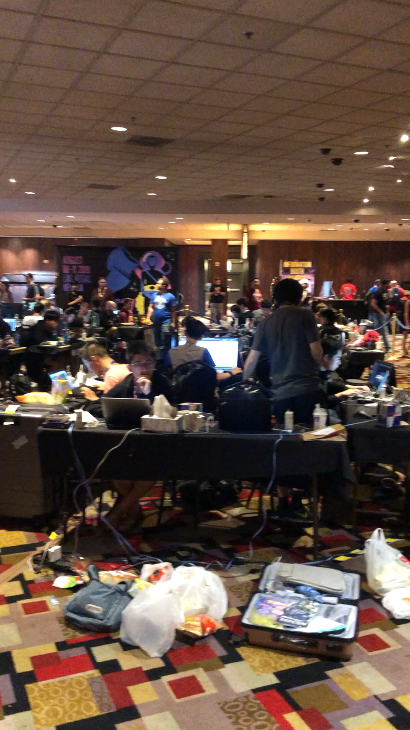

Slide 13
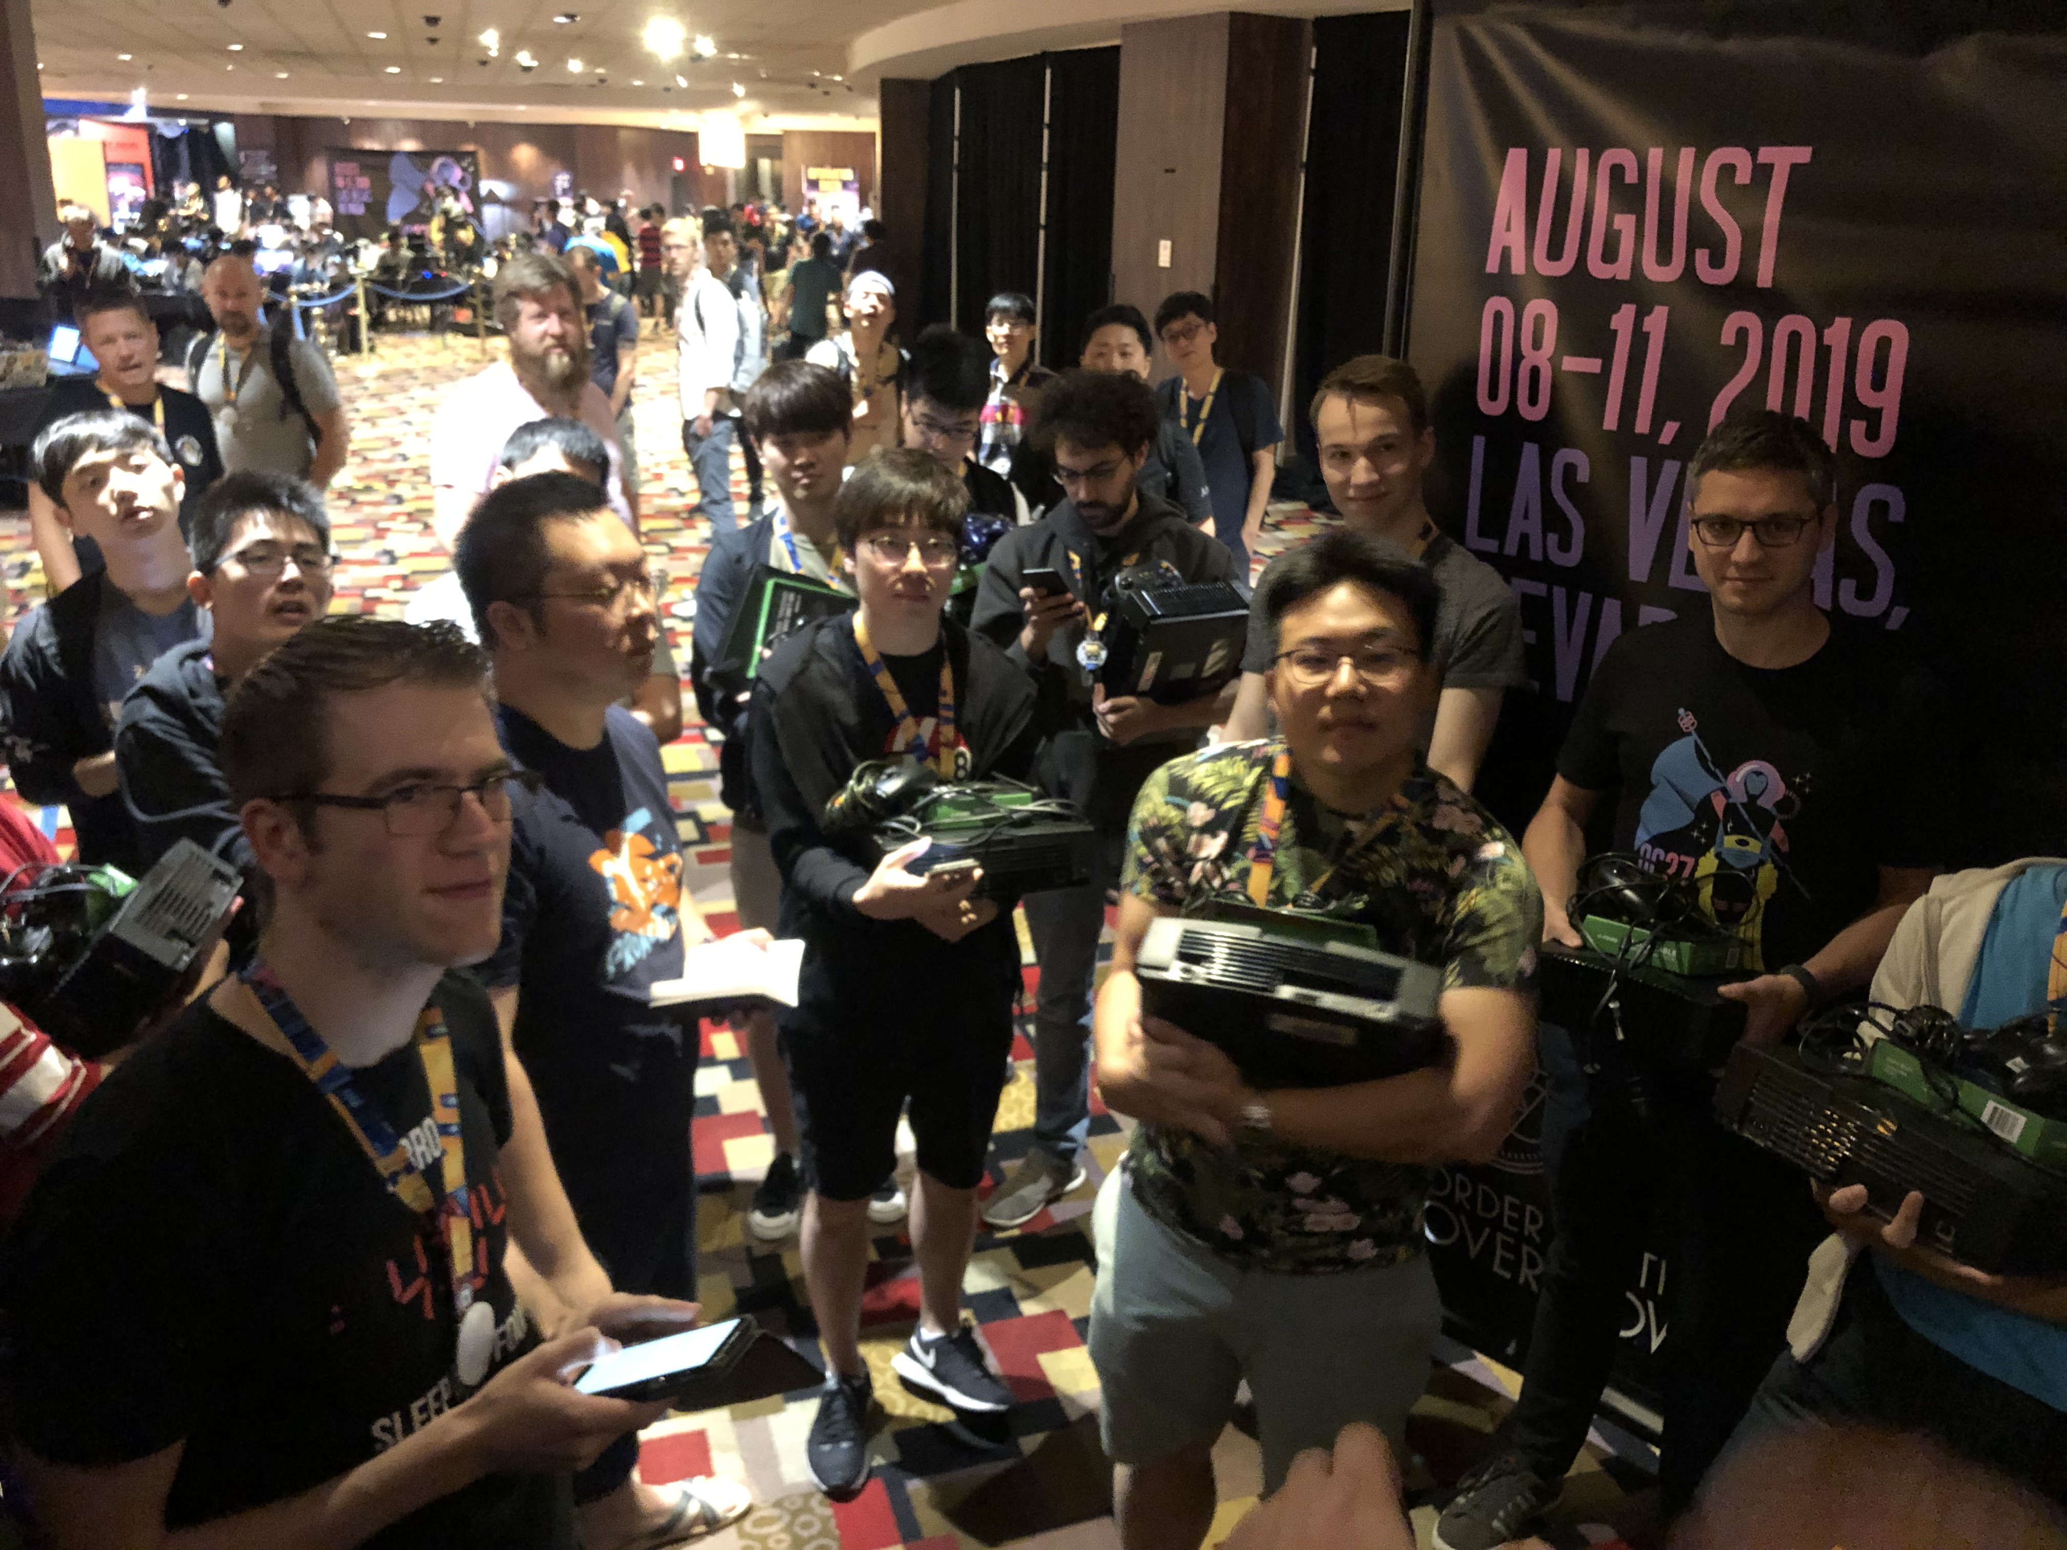

Slide 14
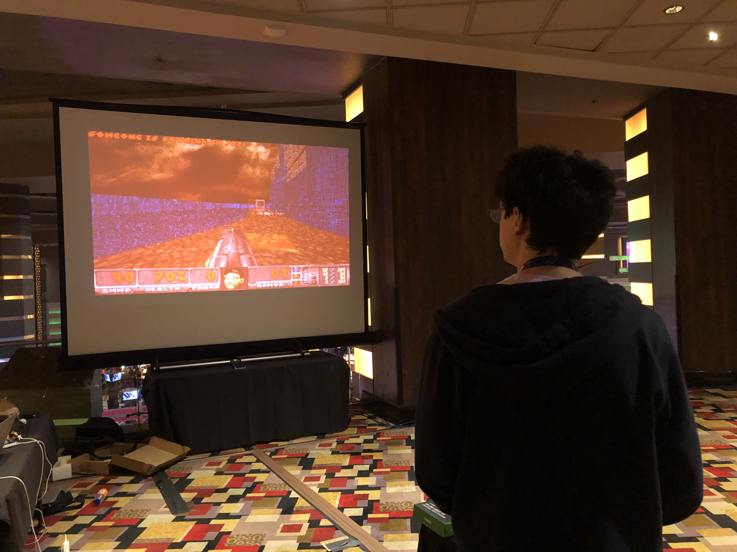

Slide 15
So what did the teams do?
Hacked iOS apps
  Via a chat app, similar to telegram
Hacked deep learning models
  Neural Networks trained on learning a flag
Hacked Lisp Machine
  Lisp Machine (from the early ‘80s) emulator running a web server
Hacked custom Doom running on Xbox
Wrote bit-flip resistant shellcode
…

Slide 17
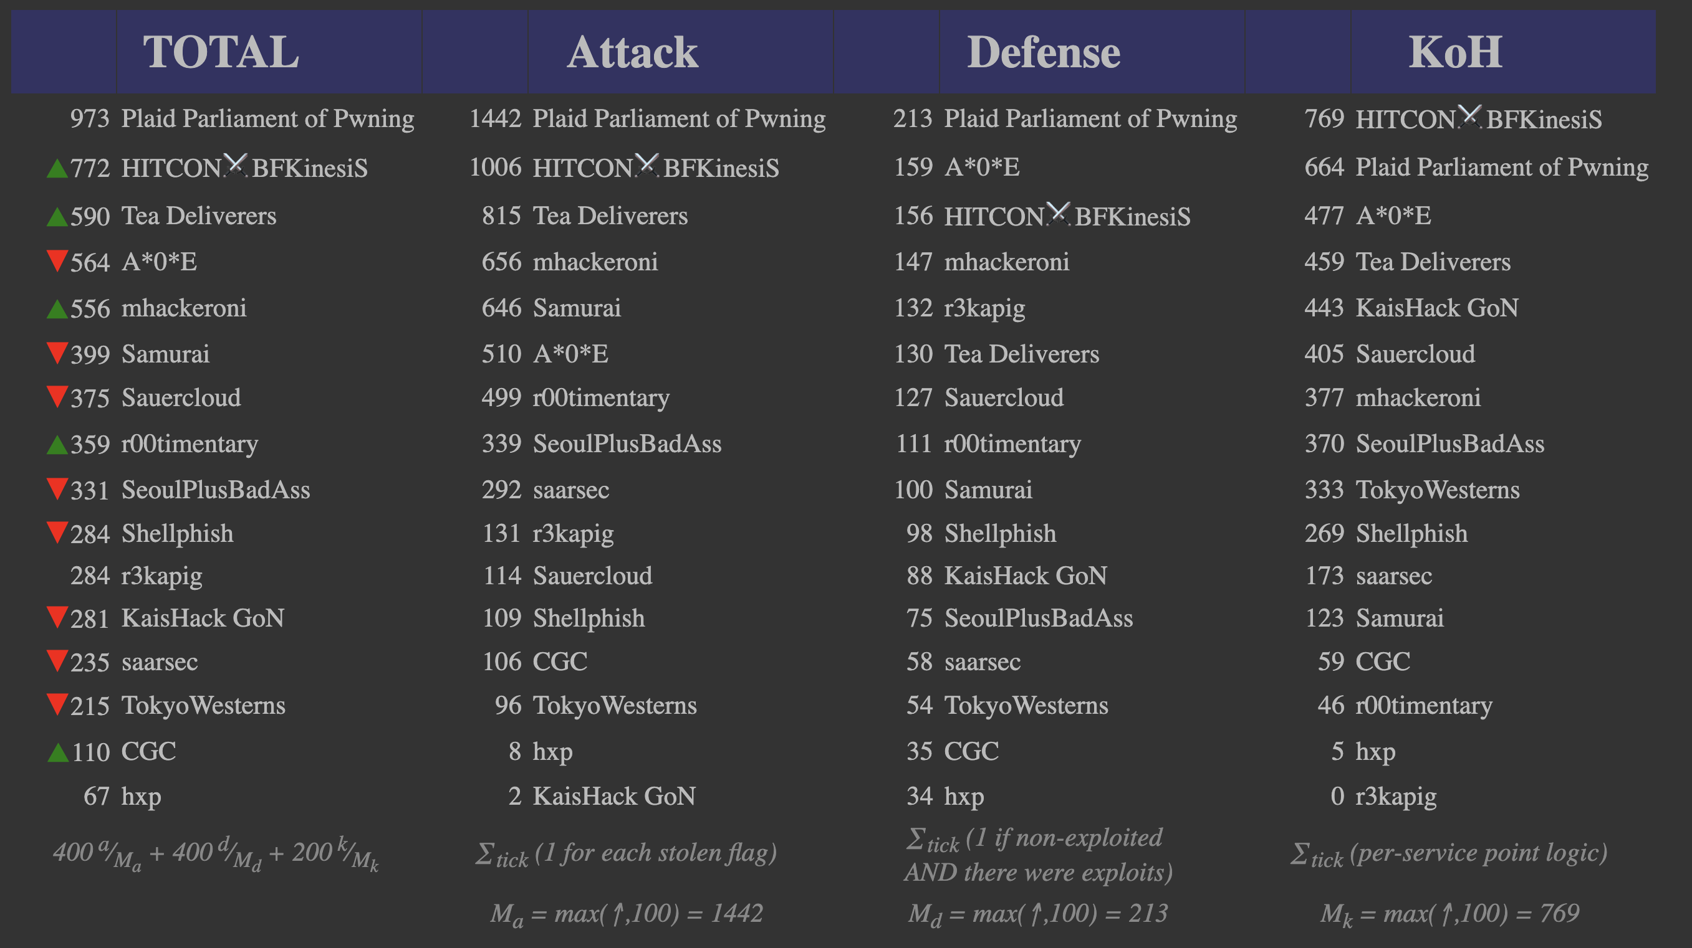

Slide 18
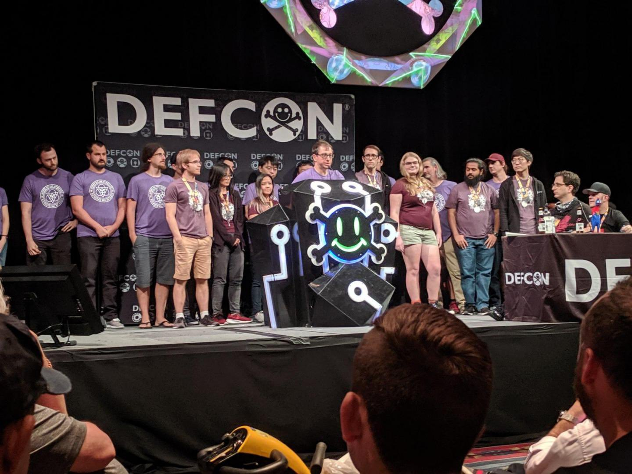

Slide 19
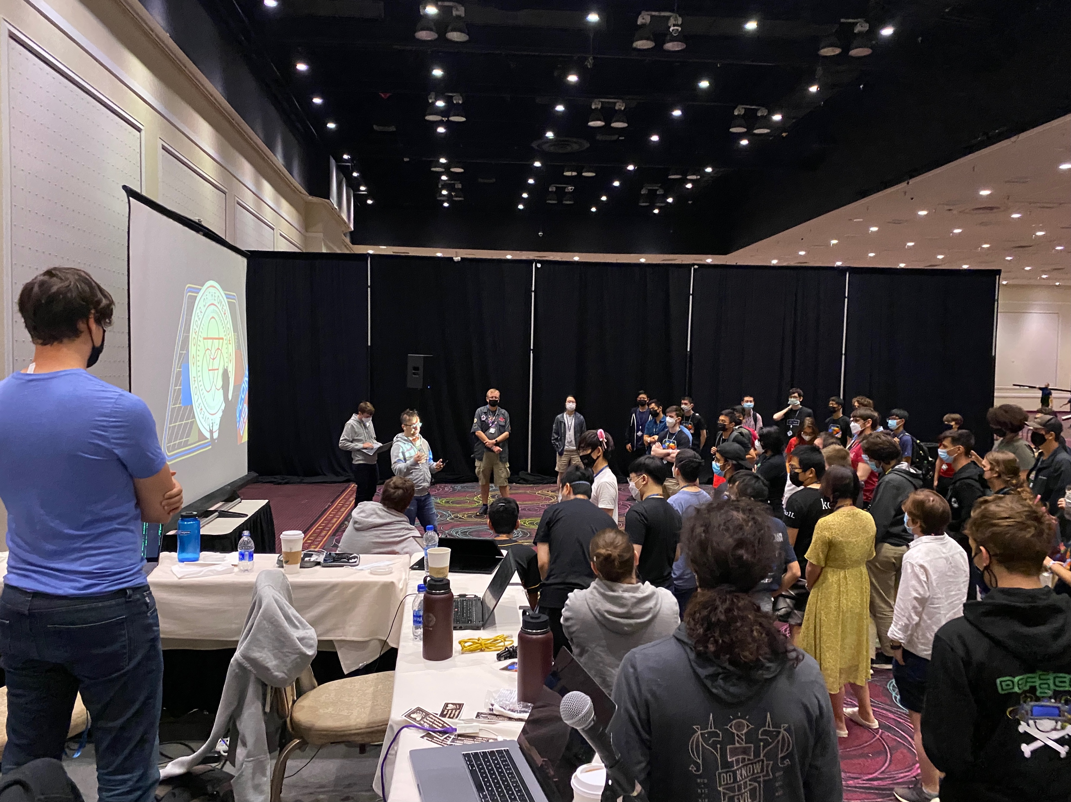

Slide 20
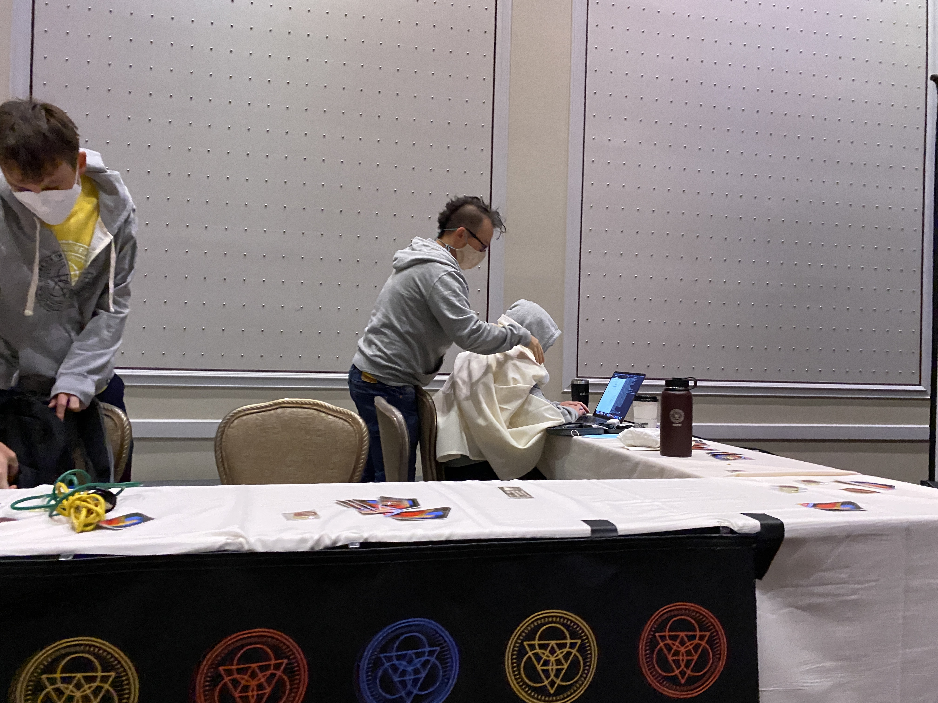

Slide 21
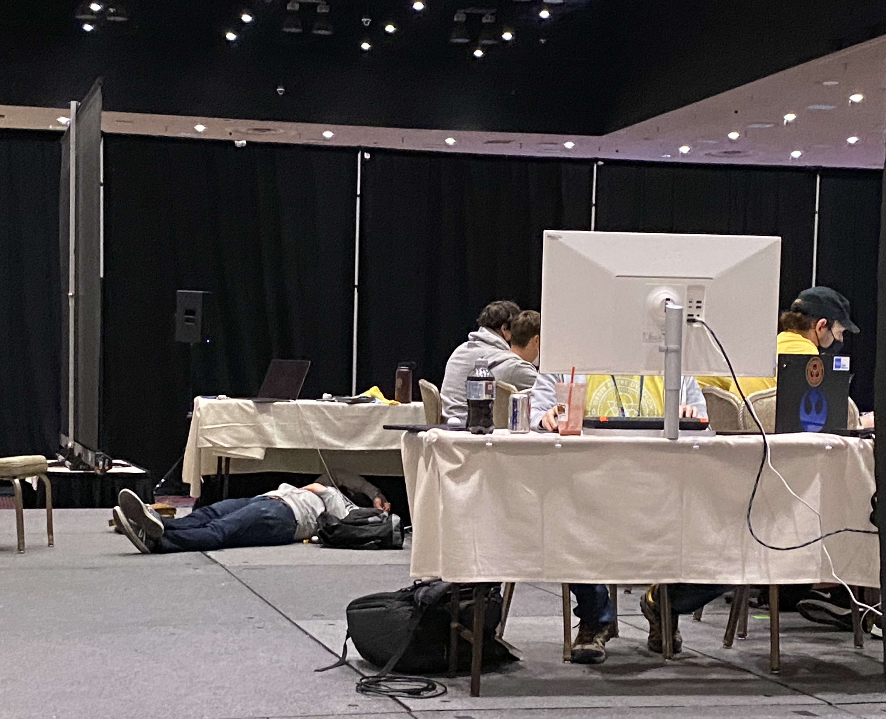

Slide 22
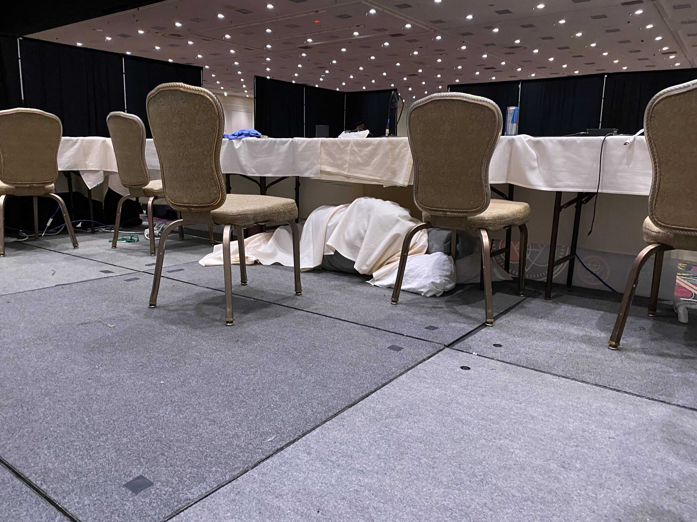

Slide 23
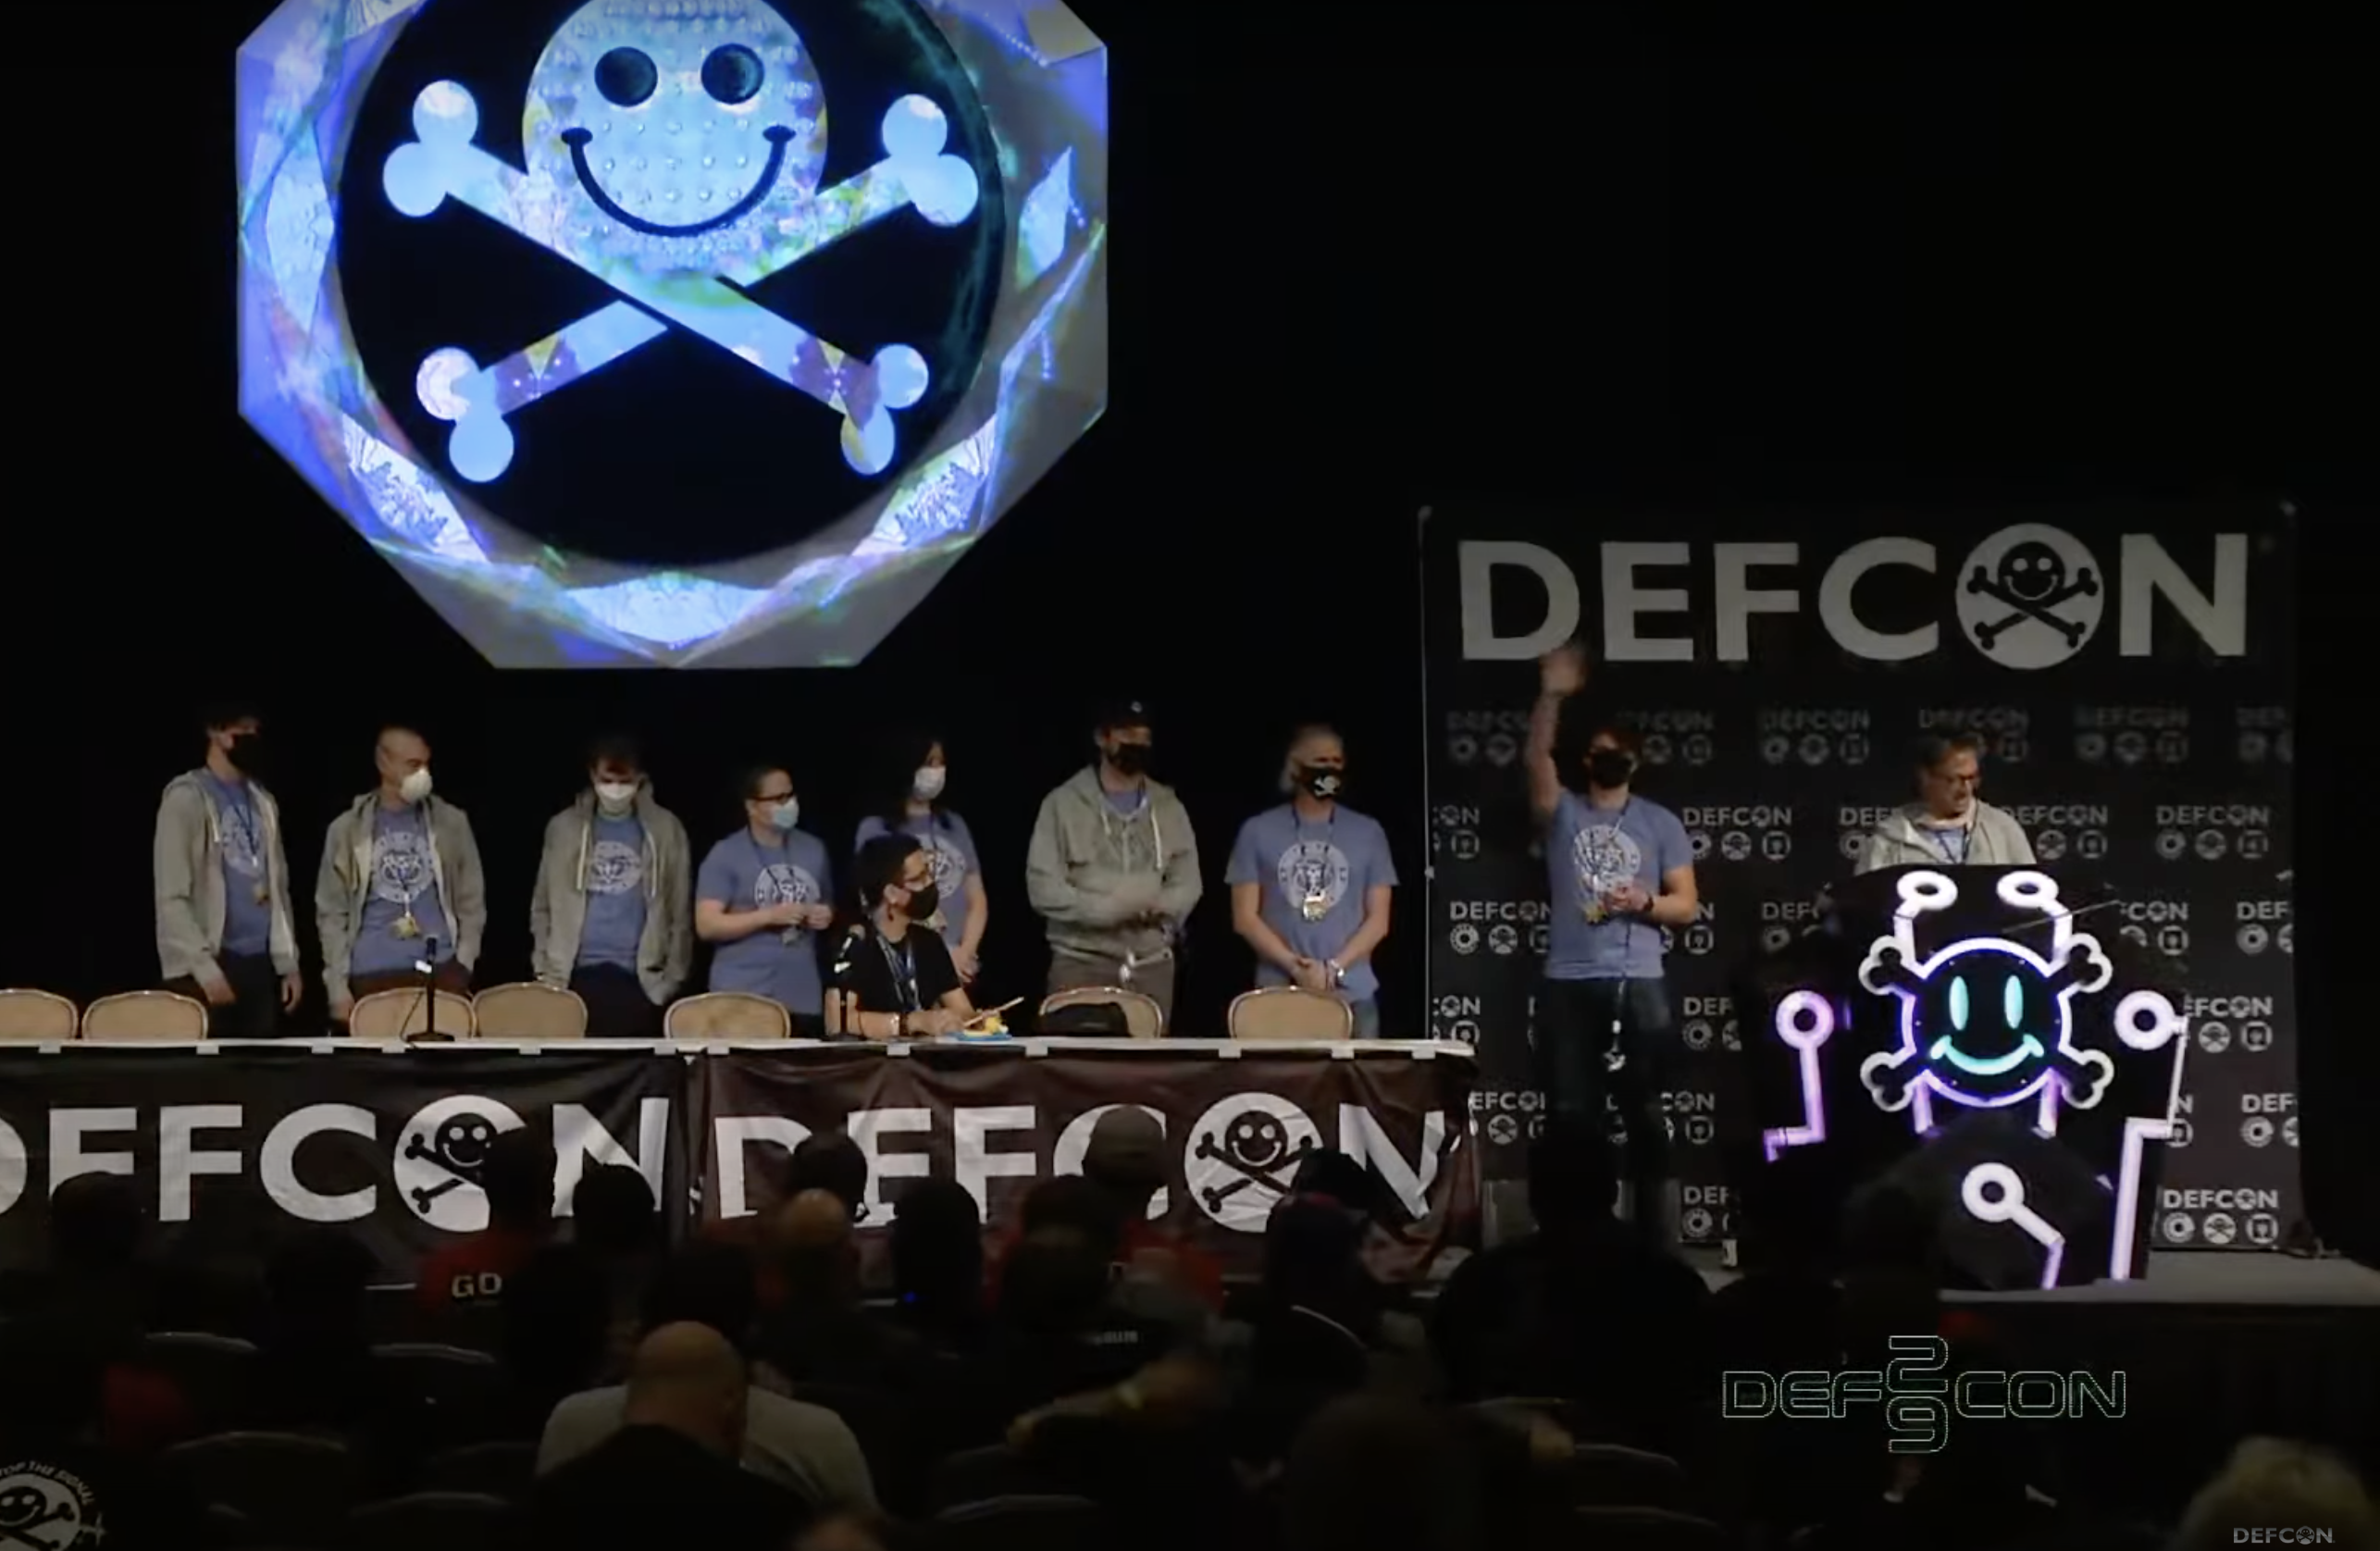

Slide 24
Security @ ASU
Two undergrad Cyber Security concentration programs
  BS in computer science
  BSE in computer systems engineering
Three graduate Cyber Security concentration programs
  MS
  MCS
  PhD
http://ia.asu.edu/education.php

Slide 25
Security @ ASU
Concentration in BS
  Minimum of 15 credits in cybersecurity and related areas as technical electives
  Required Course
    CSE 365 Introduction to Information Assurance
  Two from
    CSE 466 Computer System Security
    CSE 467 Data and Information Security
    CSE 468 Network Security
    CSE 469 Computer and Network Forensics
  Two elective courses

Slide 26
Security @ ASU
NSA and DHS designated ASU and the Cyber Security program a National Center of Academic Excellence in Information Assurance Education

Slide 27
Syllabus
https://static.pwn.college/syllabi/cse365-f23

