Slide 1
The Web
CSE 591 – Security and Vulnerability Analysis
Spring 2015
Adam Doupé
Arizona State University
http://adamdoupe.com
Content of some slides provided by Giovanni Vigna of UCSB, with approval

Slide 2
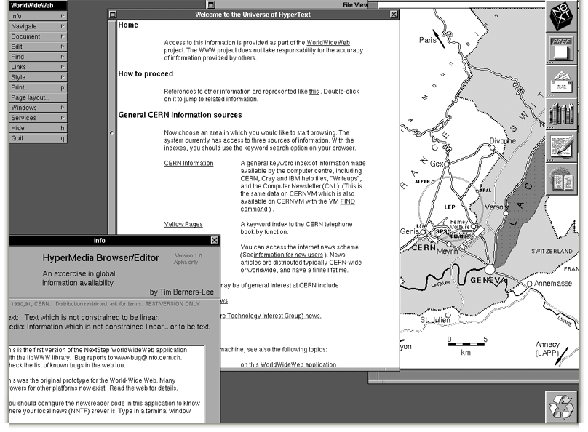
Notes:
First web browser

Slide 3
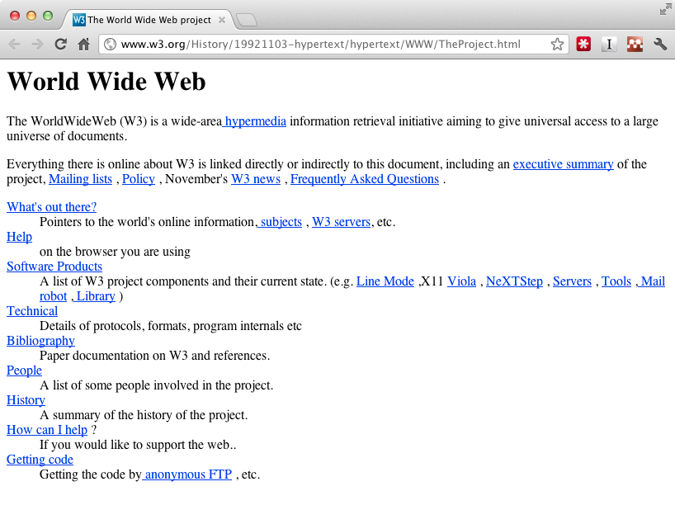
Notes:
First website

Slide 4

Sir Tim Berners-Lee

Slide 5
Birth of the Web
Created by Tim Berners-Lee while he was working at CERN
  First CERN proposal in 1989
  Finished first website end of 1990
Weaving the Web: The Original Design and Ultimate Destiny of the World Wide Web, Tim Berners-Lee
Notes:
Question: Birth of Internet and the Web?
Difference?

Slide 6
Design
Originally envisioned as a way to share research results and information at CERN
Combined multiple emerging technologies
  Hypertext
  Internet (TCP/IP)
Idea grew into “universal access to a large universe of documents”

Slide 7
Three Central Questions
How to name a resource?
How to request and serve a resource?
How to create hypertext?

Slide 8
Three Central Technologies
How to name a resource?
  Uniform Resource Identifier (URI/URL)
How to request and serve a resource?
  Hypertext Transfer Protocol (HTTP)
How to create hypertext?
  Hypertext Markup Language (HTML)

Slide 9
URI
HTTP
HTML
Notes:
Relationship between the three core technologies.
URIs describe how to make an HTTP request, and an HTTP response contains HTML, which contains data plus URIs for more information.

Slide 10
URI
HTTP
HTML
Notes:
Relationship between the three core technologies.
URIs describe how to make an HTTP request, and an HTTP response contains HTML, which contains data plus URIs for more information.

Slide 11
Uniform Resource Identifier
Essential meta-data to reach/find a resource
Answers the following questions:
  Which server has it?
  How do I ask?
  How can the server locate the resource?
Latest definition in RFC 3986 (January 2005)

Slide 12
URI – Syntax
<scheme>:<authority>/<path>?<query>#<fragment>

Slide 13
URI – Syntax
<scheme>:<authority>/<path>?<query>#<fragment>
scheme
  The protocol to use to request the resource
authority
  The entity that controls the interpretation of the rest of the URI
  Usually a server name
    <username>@<host>:<port>
path
  Usually a hierarchical pathname composed of “/” separated strings
query
  Used to pass non-hierarchical data
fragment
  Used to identify a subsection or subresource of the resource

Slide 14
URI – Syntax
<scheme>:<authority>/<path>?<query>#<fragment>
Examples:
foo://example.com:8042/over/there?test=bar#nose
ftp://ftp.ietf.org/rfc/rfc1808.txt
mailto:doupe@asu.edu
https://example.com/test/example:1.html?/adam
Notes:
What is the scheme, authority, path, query, and fragment of each example?
Is each example a URI?

Slide 15
URI – Reserved Characters
:
/
?
#
[
]
@
!
$
&
‘
(
)
*
+
,
;
=

Slide 16
URI – Percent Encoding
Must be used to encode anything that is not of the following:
Alpha [a-zA-Z]
Digit [0-9]
-
.
_
~

Slide 17
URI – Percent Encoding
Encode a byte outside the range with percent sign (%) followed by hexadecimal representation of byte
  & -> %26
  % -> %25
  <space> -> %20
  …
Let’s fix our previous example:
  https://example.com/test/example:1.html?/adam
  https://example.com/test/example%3A1.html?%2Fadam

Slide 18
URI – Absolute vs. Relative
URI can specify the absolute location of the resource
  https://example.com/test/help.html
Or the URI can specify a location relative to the current resource
  //example.com/example/demo.html
    Relative to the current network-path (scheme)
  /test/help.html
    Relative to the current authority
  ../../people.html
    Relative to the current authority and path
Context important in all cases
  http://localhost:8080/test

Slide 19
Hypertext Transport Protocol
Protocol for how a web client can request a resource from a web server
Based on TCP, uses port 80 by default
Version 1.0
  Defined in RFC 1945 (May 1996)
Version 1.1
  Defined in RFC 2616 (June 1999)
Version 2.0
  Based on SPDY, still under discussion

Slide 20
HTTP – Important Terms
user agent
  The client which initiates the request
server
  A program which accepts HTTP requests and sends HTTP responses
proxy
  An intermediary which acts as both a server and client for the purpose of making requests on behalf of other clients
Notes:
Why might you want a proxy?

Slide 21
HTTP – Overview
Client
  Opens TCP connection to the server
  Sends request to the server
Server
  Listens for incoming TCP connections
  Reads request
  Sends response
Notes:
Deliberately vague!

Slide 22



HTTP – Overview
HTTP Request
HTTP Response
Server
Client

Slide 23

HTTP – Overview
Cache
Server
Client
Cache
Firewall
Proxy

Slide 24
Requests
An HTTP request consists of:
  method
  resource (derived from the URI)
  protocol version
  client information
  body (optional)

Slide 25
Requests – Syntax
Start line, followed by headers, followed by body
  Each line separated by CRLF
Headers separated by body via empty line (just CRLF)

Slide 26
Requests – Methods
The method that that client wants applied to the resource
Common methods
    GET – Request transfer of the entity referred to by the URI
    POST – Ask the server to process the included body as “data” associated with the resource identified by the URI
    PUT – Request that the enclosed entity be stored under the supplied URI
    HEAD – Identical to GET except server must not return a body

Slide 27
Requests – Methods
OPTIONS – Request information about the communication options available on the request/response chain identified by the URL
DELETE – Request that the server delete the resource identified by the URI
TRACE – used to invoke a remote, application-layer loop-back of the request message and the server should reflect the message received back to the client as the body of the response
CONNECT – used with proxies
…
  A webserver can define arbitrary extension methods

Slide 28
Requests – Example
GET / HTTP/1.1
User-Agent: curl/7.37.1
Host: www.google.com
Accept: */*

Slide 29
Host Header and HTTP/1.1
In HTTP 1.0, it is not possible to discern, from the request line, which server was intended to process the request:
GET / HTTP/1.0
Thus, it is not possible to associate multiple server names to the same IP address
  What would happen if every server name had to have its own IP address?
In HTTP 1.1, the “Host” header is required, and it specifies which server name is the intended recipient
GET / HTTP/1.1
Host: example.com

Slide 30
Modern Requests
GET / HTTP/1.1
Host: www.google.com
Accept-Encoding: deflate, gzip
Accept: text/html,application/xhtml+xml,application/xml;q=0.9,image/webp,*/*;q=0.8
User-Agent: Mozilla/5.0 (Macintosh; Intel Mac OS X 10_10_1) AppleWebKit/537.36 (KHTML, like Gecko) Chrome/39.0.2171.95 Safari/537.36
Notes:
From Chrome to www.google.com

Slide 31
Responses
An HTTP response consists of:
  protocol version
  status code
  short reason
  headers
  body
Notes:
This is where we ended the first day.

Slide 32
Responses – Syntax
Status line, followed by headers, followed by body
  Each line separated by CRLF
Headers separated by body via empty line (just CRLF)
Almost the same overall structure as request

Slide 33
Responses – Status Codes
1XX – Informational: request received, continuing to process
2XX – Successful: request received, understood, and accepted
3XX – Redirection: user agent needs to take further action to fulfill the request
4XX – Client error: request cannot be fulfilled or error in request
5XX – Server error: the server is aware that it has erred or is incapable of performing the request

Slide 34
Responses – Status Codes
"200" ; OK
"201" ; Created
"202" ; Accepted
"204" ; No Content
“301" ; Moved Permanently
"307" ; Temporary Redirect

Slide 35
Responses – Status Codes
"400" ; Bad Request
"401" ; Unauthorized
"403" ; Forbidden
"404" ; Not Found
"500" ; Internal Server Error
"501" ; Not Implemented
"502" ; Bad Gateway
"503" ; Service Unavailable

Slide 36
Requests – Example
GET / HTTP/1.1
User-Agent: curl/7.37.1
Host: www.google.com
Accept: */*

Slide 37
Responses – Example
HTTP/1.1 200 OK
Date: Tue, 13 Jan 2015 03:57:26 GMT
Expires: -1
Cache-Control: private, max-age=0
Content-Type: text/html; charset=ISO-8859-1
Set-Cookie: …
Server: gws
X-XSS-Protection: 1; mode=block
X-Frame-Options: SAMEORIGIN
Alternate-Protocol: 80:quic,p=0.02
Accept-Ranges: none
Vary: Accept-Encoding
Transfer-Encoding: chunked
<!doctype html><html itemscope="" itemtype="http://schema.org/WebPage" lang="en"><head><meta content="Search the world's information, including webpages, images, videos and more. Go …

Slide 38
HTTP Authentication
Based on a simple challenge-response scheme
The challenge is returned by the server as part of a 401 (unauthorized) reply message and specifies the authentication schema to be used
An authentication request refers to a realm, that is, a set of resources on the server
The client must include an Authorization header field with the required (valid) credentials

Slide 39
HTTP Basic Authentication
The server replies to an unauthorized request with a 401 message containing the header field
WWW-Authenticate: Basic realm="ReservedDocs"
The client retries the access including in the header a field containing a cookie composed of base64 encoded (RFC 2045) username and password
Authorization: Basic QWxhZGRpbjpvcGVuIHNlc2FtZQ==
Can you crack the username/password?

Slide 40
HTTP 1.1 Authentication
Defines an additional authentication scheme based on cryptographic digests (RFC 2617)
  Server sends a nonce as challenge
  Client sends request with digest of the username, the password, the given nonce value, the HTTP method, and the requested URL
To authenticate the users the web server has to have access to clear-text user passwords

Slide 41
Monitoring and Modifying HTTP Traffic
HTTP traffic can be analyzed in different ways
  Sniffers can be used to collect traffic
  Servers can be configured to create extensive logs
  Browsers can be used to analyze the content received from a server
  Client-side/server-side proxies can be used to analyze the traffic without having to modify the target environment
Client-side proxies are especially effective in performing vulnerability analysis because they allow one to examine and modify each request and reply
  Firefox extensions: LiveHTTPHeaders, Tamper Data
  Burp Proxy
    This is a professional-grade tool that I use

Slide 42
Hypertext Markup Language
A simple data format used to create hypertext documents that are portable from one platform to another
Based on Standard Generalized Markup Language (SGML) (ISO 8879:1986)
HTML 2.0
  Proposed in RFC 1866 (November 1995)
HTML 3.2
  Proposed as World Wide Web Consortium (W3C) recommendation (January 1997)
HTML 4.01
  Proposed as W3C recommendation (December 1999)
XHTML 1.0
  Attempt by W3C to reformulate HTML into Extensible Markup Language (XML) (January 2000)
HTML 5.0
  Proposed as W3C recommendation (October 2014)
HTML 5.1
  Under development

Slide 43
HTML – Overview
Basic idea is to “markup” document with tags, which add meaning to raw text
Start tag:
  <foo>
Followed by text
End tag:
  </foo>
Self-closing tag:
  <bar />
Void tags (have no end tag):
  <img>

Slide 44
HTML – Tags
Tag are hierarchical

Slide 45
HTML – Tags
<html>
<head>
<title>Example</title>
</head>
<body>
<p>I am the example text</p>
</body>
</html>

Slide 46
HTML – Tags
<html>
  <head>
    <title>
      Example
  <body>
    <p>
      I am the example text

Slide 47
HTML – Tags
Tags can have “attributes” that provide metadata about the tag
Attributes live inside the start tag after the tag name
Four different syntax
  <foo bar>
    foo is the tag name and bar is an attribute
  <foo bar=baz>
    The attribute bar has the value baz
  <foo bar='baz'>
  <foo bar="baz">
Multiple attributes are separated by spaces
  <foo bar='baz' disabled required="true">

Slide 48

HTML – Hyperlink
anchor tag is used to create a hyperlink
href attribute is used provide the URI
Text inside the anchor tag is the text of the hyperlink
<a href="http://google.com">Example</a>
Notes:
AKA putting the hypertext in HTML.
What does href stand for?

Slide 49
HTML – Basic HTML 5 Page
<!DOCTYPE html>
<html>
<head>
<meta charset="UTF-8">
<title>CSE 591</title>
</head>
<body>
<a href="http://example.com/">Text</a>
</body>
</html>

Slide 50
HTML – Browsers
User agent is responsible for parsing and interpreting the HTML and displaying it to the user

Slide 51
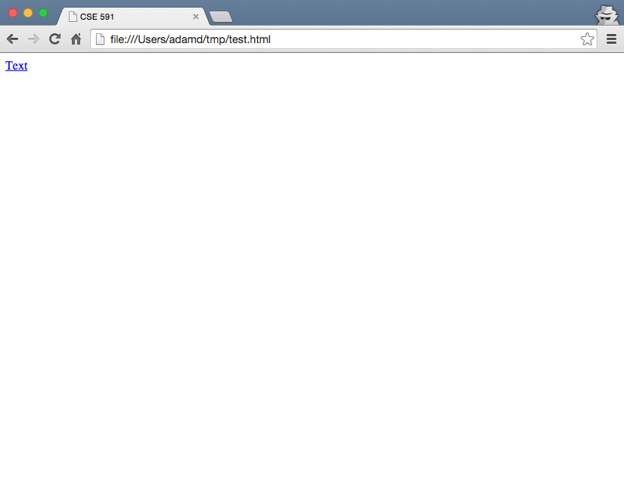
HTML – Parsed HTML 5 Page

Slide 52
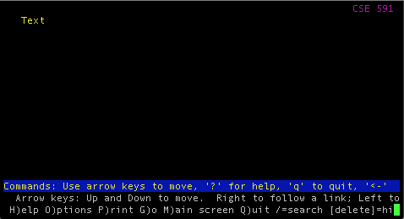
HTML – Parsed HTML 5 Page

Slide 53
HTML – Character References
How to include HTML special characters as text/data?
< > ' " & =
  Encode the character reference
  Also referred to in HTML < 5.0 as “entity reference” or “entity encoding”
Three types, each starts with & and ends with ;
  Named character reference
    &<predefined_name>;
  Decimal numeric character reference
    &#<decimal_unicode_code_point>;
  Hexadecimal numeric character reference
    &#x<hexadecimal_unicode_code_point>;
Note: This will be the root of a significant number of vulnerabilities and is critical to understand

Slide 54
HTML – Character References Example
The ampersand (&) is used to start a character reference, so it must be encoded as a character reference
&amp;
&#38;
&#x26;
&#x00026;

Slide 55
HTML – Character References Example
é
&eacute;
&#233;
&#xe9;

Slide 56
HTML – Character References Example
Why must < be encoded as a character reference?
&lt;
&#60;
&#x30;
&#x00030;

Slide 57
HTML – Forms
A form is a component of a Web page that has form controls, such as text fields, buttons, checkboxes, range controls, or color pickers
  Form is a way to create a complicated HTTP request
action attribute contains the URI to submit the HTTP request
  Default is the current URI
method attribute is the HTTP method to use in the request
  GET or POST, default is GET

Slide 58
HTML – Forms
Children input tags of the form are transformed into either query URL parameters or HTTP request body
Difference is based on the method attribute
  GET passes data in the query
  POST passes data in the body
Data is encoded as either “application/x-www-form-urlencoded” or “multipart/form-data”
  GET always uses “application/x-www-form-urlencoded”
  POST depends on enctype attribute of form, default is “application/x-www-form-urlencoded”
  "multipart/form-data" is mainly used to upload files, so we will focus on “application/x-www-form-urlencoded”

Slide 59

HTML – Forms
Data sent as name-value pairs
  Data from the input tags (as well as others)
  <input type="text" name="foo" value="bar">
Name is taken from the input tag’s name attribute
Value is taken either from the input tag’s value attribute or the user-supplied input
  Empty string if neither is present

Slide 60
application/x-www-form-urlencoded
All name-value pairs of the form are encoded
form-urlencoding encodes the name-value pairs using percent encoding
  Except that spaces are translated to + instead of %20
  foo=bar
Multiple name-value pairs separated by ampersand (&)

Slide 61
application/x-www-form-urlencoded
  <form action="http://example.com/grades/submit">
  <input type="text" name="student" value="bar">
  <input type="text" name="class">
  <input type="text" name="grade">
  <input type="submit" name="submit">
  </form>
  http://example.com/grades/submit?student=Adam+Doupé&class=cse+591&grade=A%2B&submit=Submit

Slide 62
application/x-www-form-urlencoded
  <form action="http://example.com/grades/submit" method="POST">
  <input type="text" name="student" value="bar">
  <input type="text" name="class">
  <input type="text" name="grade">
  <input type="submit" name="submit">
  </form>
POST /grades/submit HTTP/1.1
Host: example.com
User-Agent: Mozilla/5.0 (Macintosh; Intel Mac OS X 10.10; rv:34.0) Gecko/20100101 Firefox/34.0
Accept: text/html,application/xhtml+xml,application/xml;q=0.9,*/*;q=0.8
Accept-Language: en-US,en;q=0.5
Accept-Encoding: gzip, deflate
Connection: keep-alive
Content-Type: application/x-www-form-urlencoded
Content-Length: 68
student=Adam+Doup%C3%A9&class=cse+591&grade=A%2B&submit=Submit+Query
Notes:
Why do we need the Content-Length header?

Slide 63
The Web
URI/URL describes where to locate a document
HTTP describes how to ask for a document
HTML anchors and forms describe how to find more information, by describing URIs and HTTP requests

Slide 64
Technologies Discussed
URI
Percent Encoding
HTTP Request
HTTP Response
HTTP Authentication
HTML
HTML Character References
Form Urlencoding

