Slide 1
Introduction to Information Assurance
CSE 365 – Information Assurance
Fall 2018
Adam Doupé
Arizona State University
http://adamdoupe.com

Slide 2
Introduction
Professor Adam Doupé
PhD at UCSB
Played CTF with Shellphish, then started the pwndevils
Next meeting Thursday 8/16, 4pm BYENG 209
http://pwndevils.com/
TA Faris Bugra Kokulu
PhD student at ASU
Awesome research into SOC security

Slide 3
DEF CON CTF

Slide 4
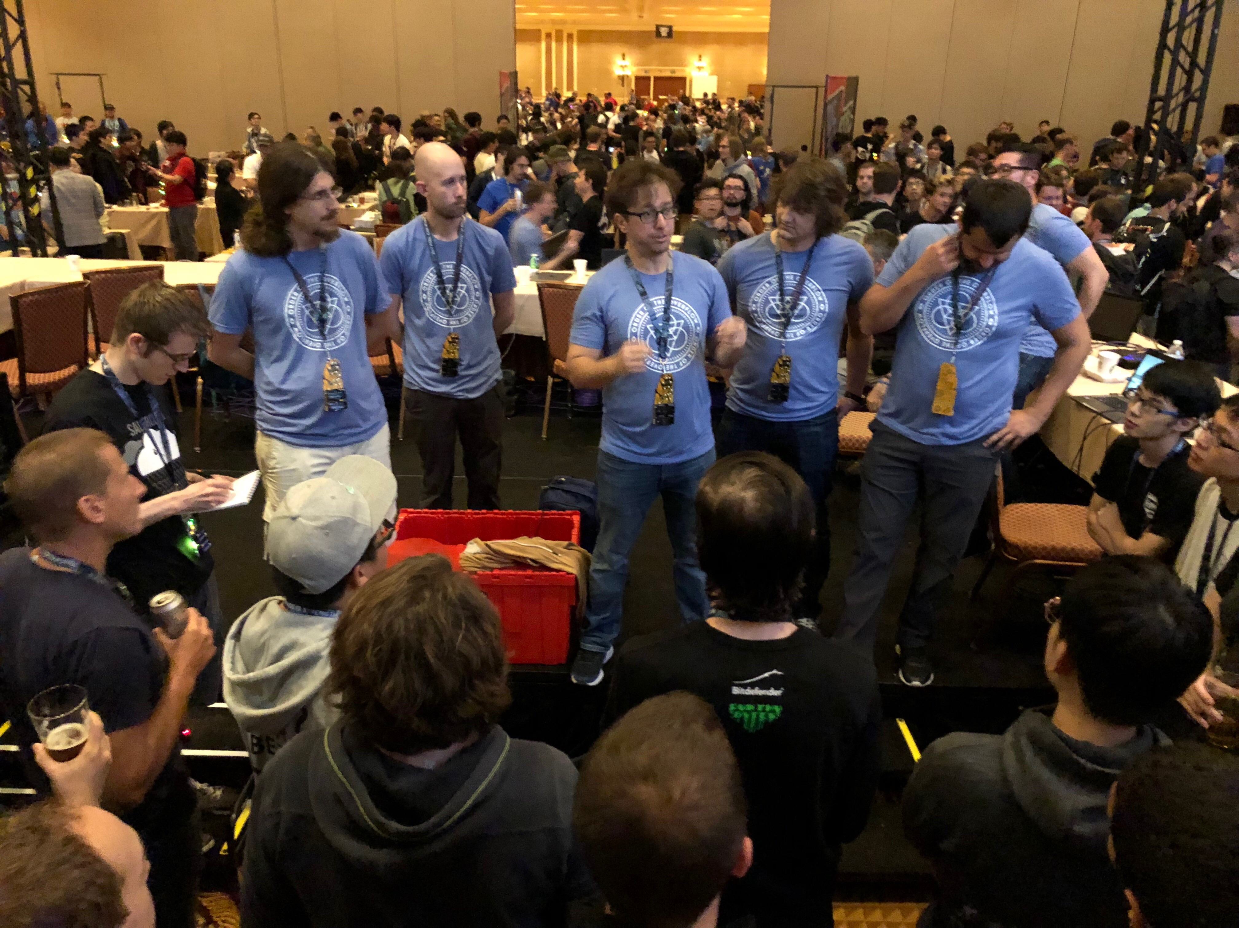

Slide 5
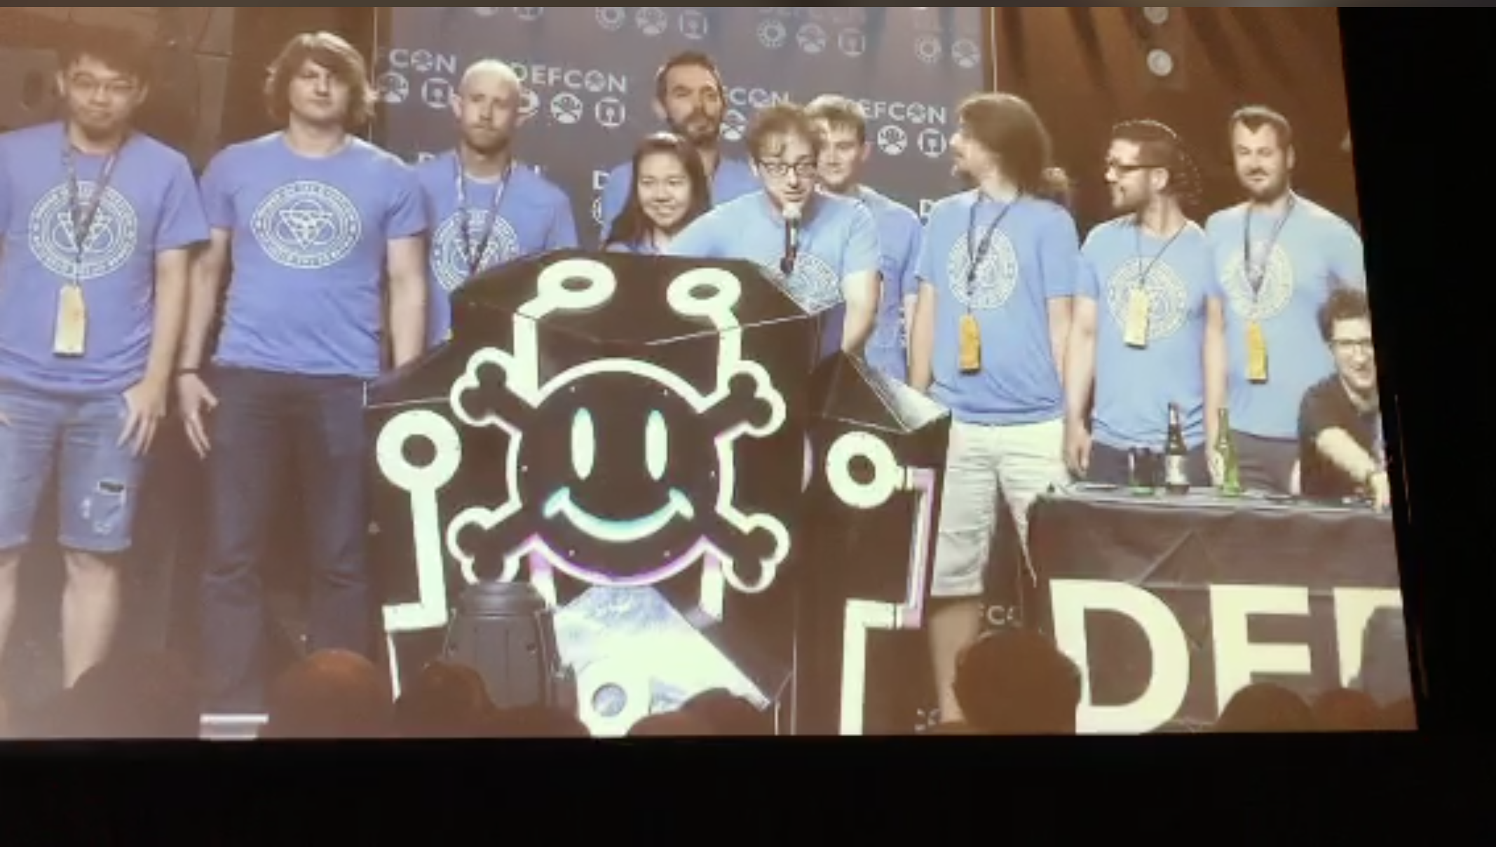

Slide 6
DEFKOR00T Wins!

Slide 7
Security @ ASU
Two undergrad Cyber Security concentration programs
BS in computer science
BSE in computer systems engineering
Three graduate Cyber Security concentration programs
MS
MCS
PhD
http://ia.asu.edu/education.php

Slide 8
Security @ ASU
Concentration in BS
Minimum of 15 credits in Cyber Security and related areas as technical electives
Core courses
CSE 365 Introduction to Information Assurance
CSE 466 Computer System Security
CSE 467 Data and Information Security
CSE 468 Network Security
CSE 469 Computer and Network Forensics

Slide 9
Security @ ASU
NSA and DHS designated ASU and the Cyber Security program a National Center of Academic Excellence in Information Assurance Education

Slide 10
Syllabus
https://adamdoupe.com/teaching/classes/cse365-information-assurance-f18/syllabus.html

